Slide 1

Lecture 4 Analysis of epidemic time-series part 1: quantifying temporal trends
Lecturer: Oliver Eales

Slide 2
What is an epidemic time series?
A quantity measured at successive equally spaced points in time.
Could be measured: daily, weekly, monthly, etc
Value at current time point depends on previous time points. i.e. data points are not independent
Examples quantities include:
Cases
Hospitalisations
Deaths
Note that the time series of infections is rarely measured

Slide 3
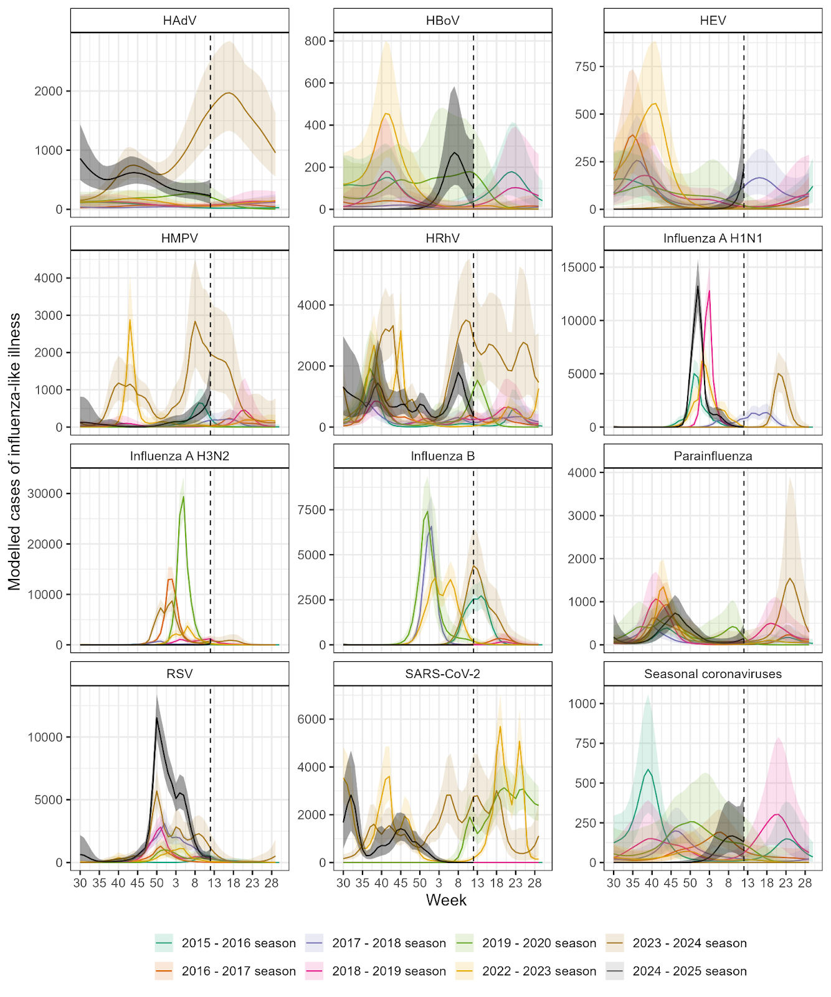
Why do we analyse epidemic time series?
By analysing past and current trends, we can predict future trends
For example:
Analysing past seasonal dynamics of respiratory pathogens can inform predictions of onset, peak timing, and peak burden for future seasons
Influenza-like illness

Slide 4
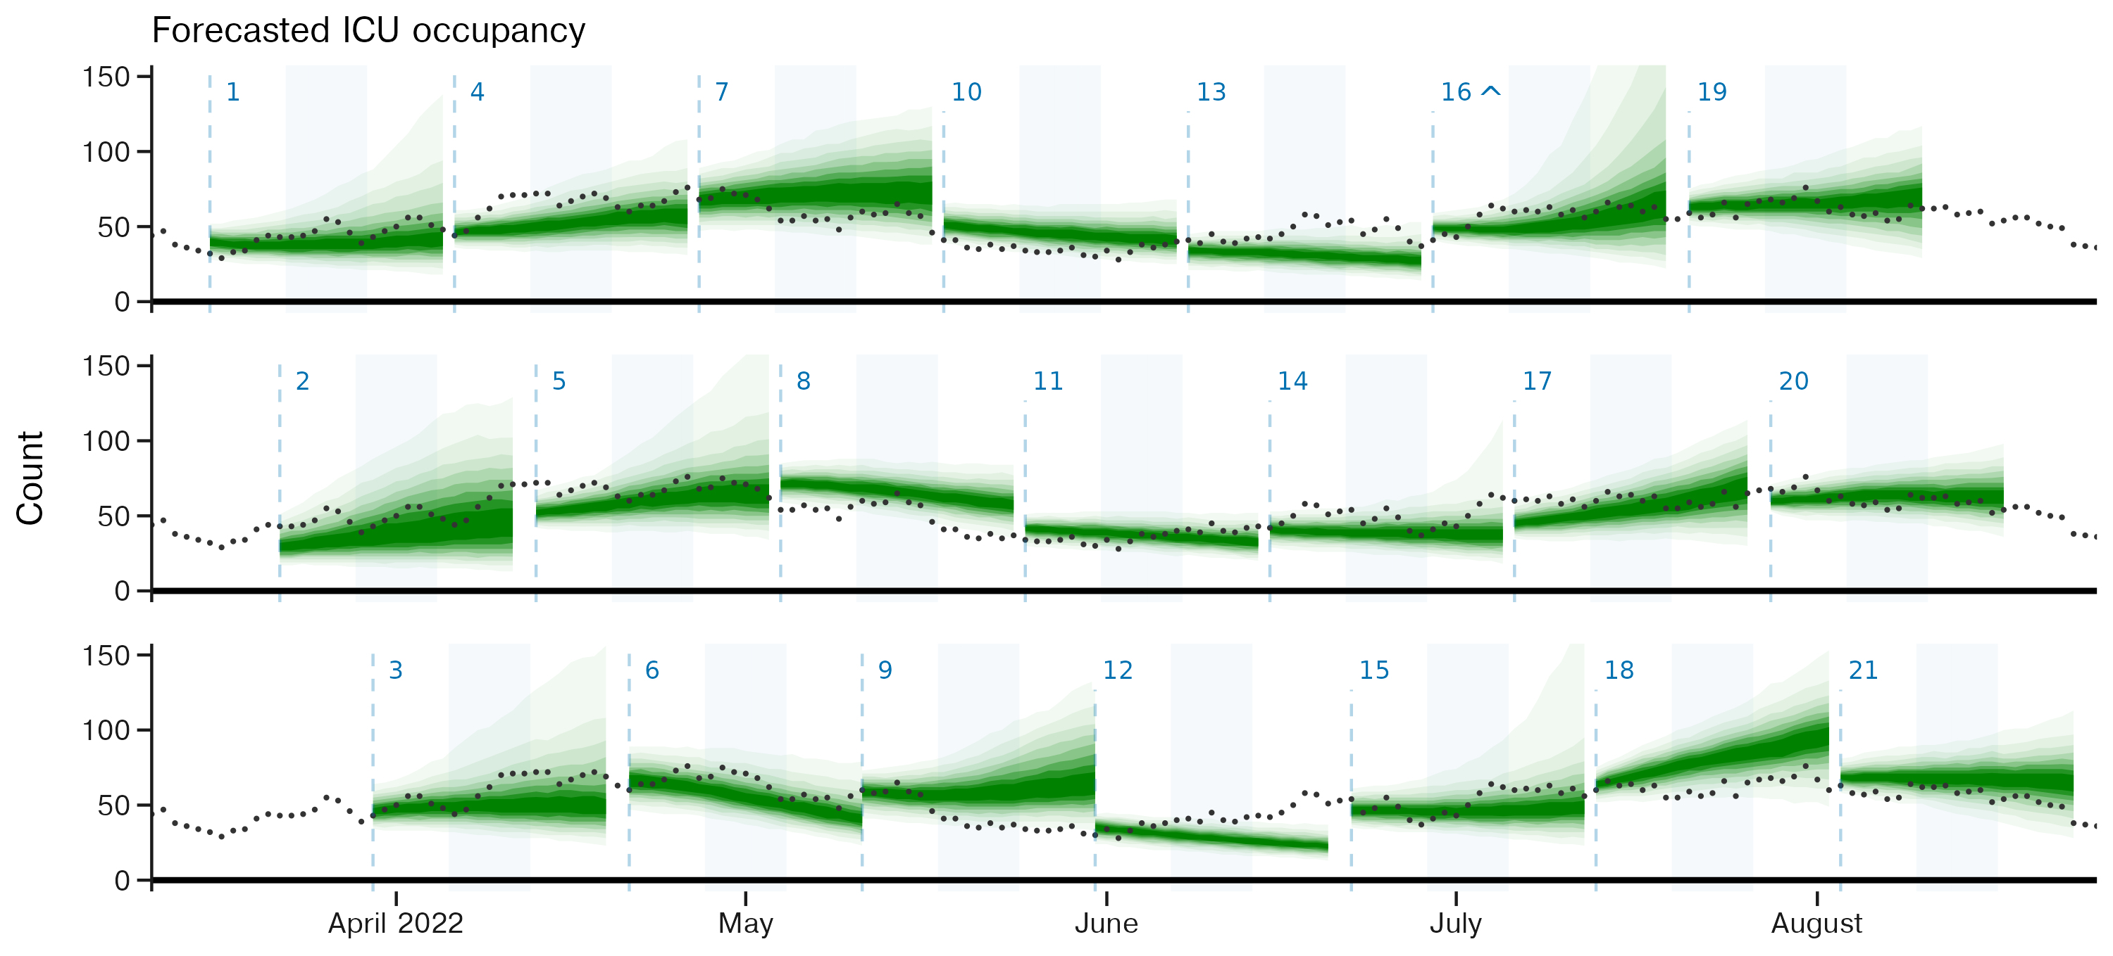
Why do we analyse epidemic time series?
By analysing past and current trends, we can predict future trends
For example:
Current trends can be indicative of short-term future trends
Tobin et al. 2025. Communications Medicine
Notes:
Tobin et al 2025

Slide 5
This lecture’s scope
In this lecture we will:
Describe why transmission can change over time and why it is important to monitor
Present two mathematical formulations for quantifying these changes: the effective reproduction number and the epidemic growth rate
Relate these quantities to an exemplar time series of infections
We will not cover:
“Noisy” or delayed time series data — this will be covered in lecture 5 (analysis of epidemic time-series part II)
Handling of epidemic time series comprised of signals from multiple pathogens — this will be covered in lecture 6 (analysis of epidemic time-series part III)

Slide 6

The effective reproduction number, $R_{e}$

Slide 7
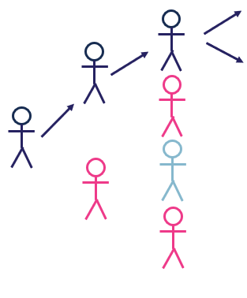


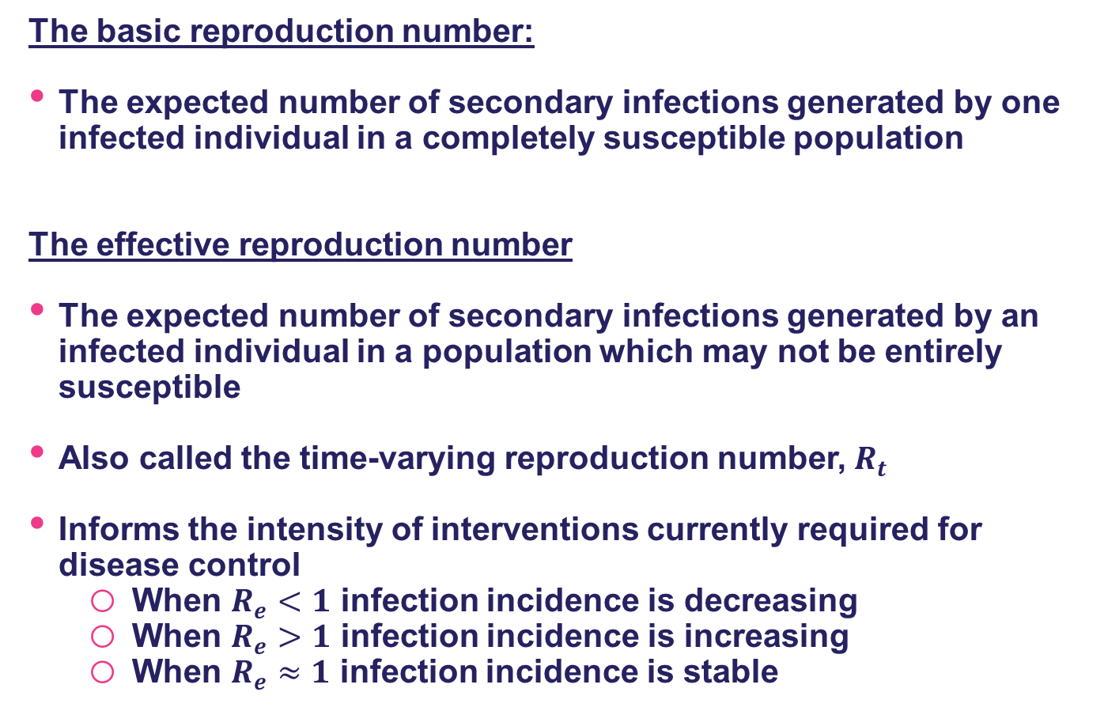

The effective reproduction number, $R_{e}$
The basic reproduction number:
The expected number of secondary infections generated by one infected individual in a completely susceptible population
The effective reproduction number
The expected number of secondary infections generated by an infected individual in a population which may not be entirely susceptible
Also called the time-varying reproduction number, $R_{t}$
Informs the intensity of interventions currently required for disease control
When $R_{e}<1$ infection incidence is decreasing
When $R_{e}>1$ infection incidence is increasing
When $R_{e}≈1$ infection incidence is stable
Infections
Immune
Not infected

Slide 8

Why does $R_{e}$change through time?
Changes in the susceptibility of the population
Decreases in susceptibility due to infection- and vaccine-induced immunity
Increases in susceptibility due to waning immunity or new susceptibles (e.g. births)
Changes in the infectiousness of the pathogen
Decreases in infectiousness due to infection- and vaccine-induced immunity
Decreases in infectiousness due to antivirals
New variants with altered transmissibility
Changes in contact rates and other behaviours
Lockdowns can reduce all contact
School or workplace closures will change contact rates for subsets of the population
Isolation and quarantine can reduce contact between infectious and susceptible individuals

Slide 9

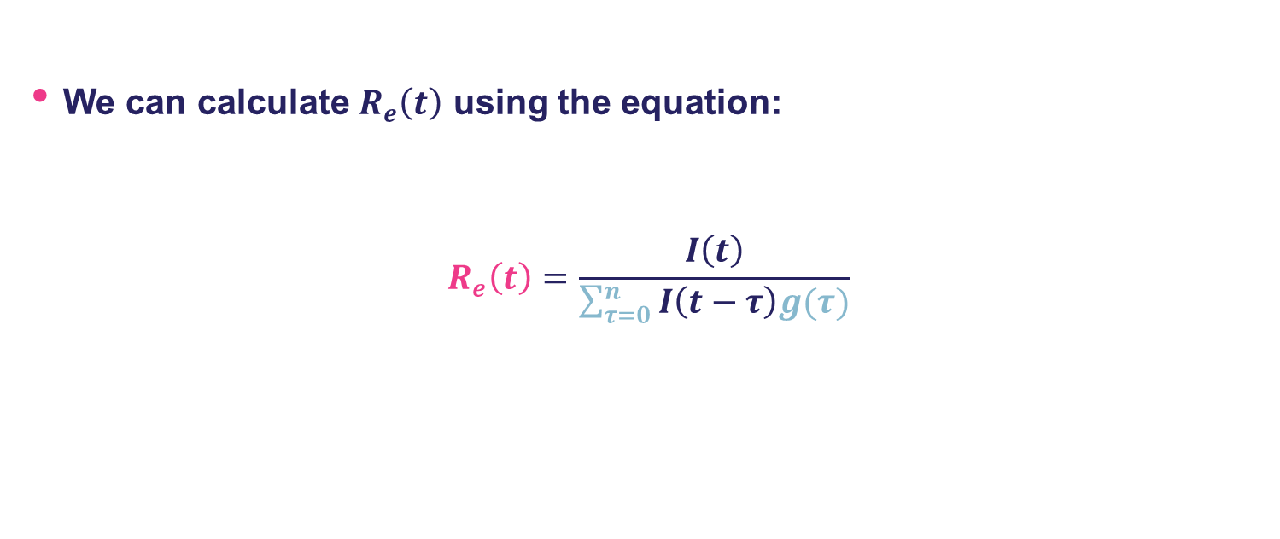
How do we calculate $R_{e}\left(t\right)$?
We can calculate $R_{e}\left(t\right)$ using the equation:
$$R_{e}\left(t\right)=\frac{I\left(t\right)}{\sum_{τ=0}^{n}{I\left(t−τ\right)g(τ)}}$$
Infection incidence on the current day
Effective reproduction number
GI distribution
Infections incidence on previous days

Slide 10
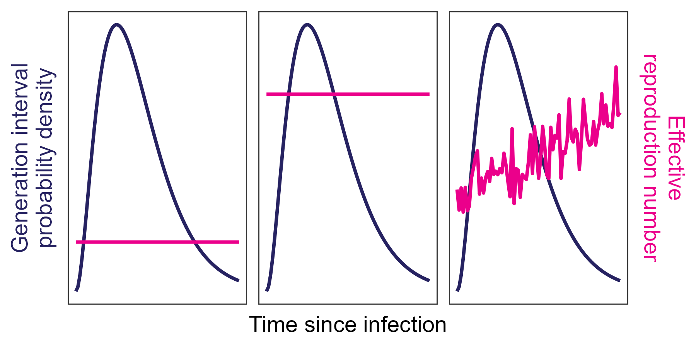
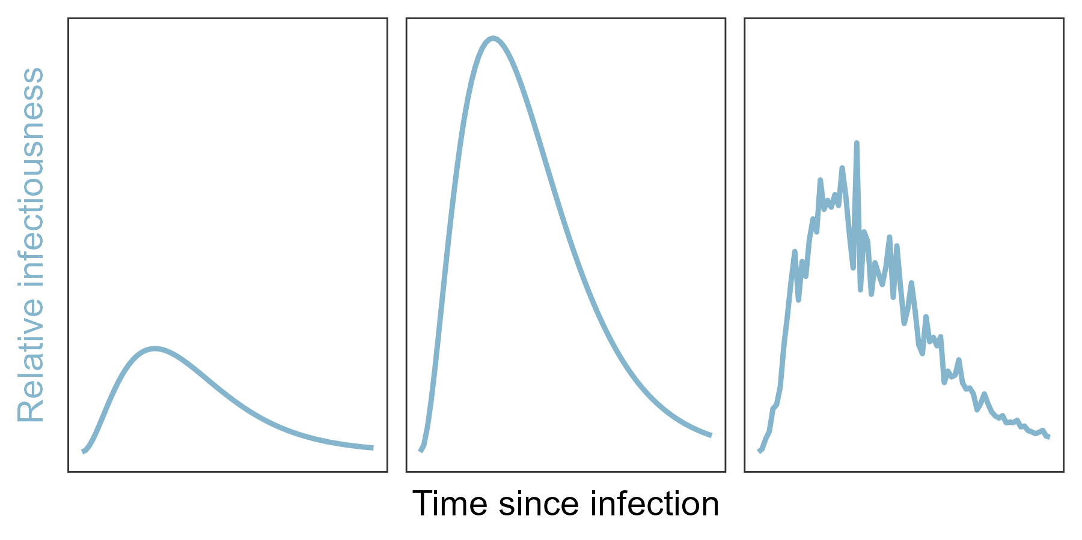
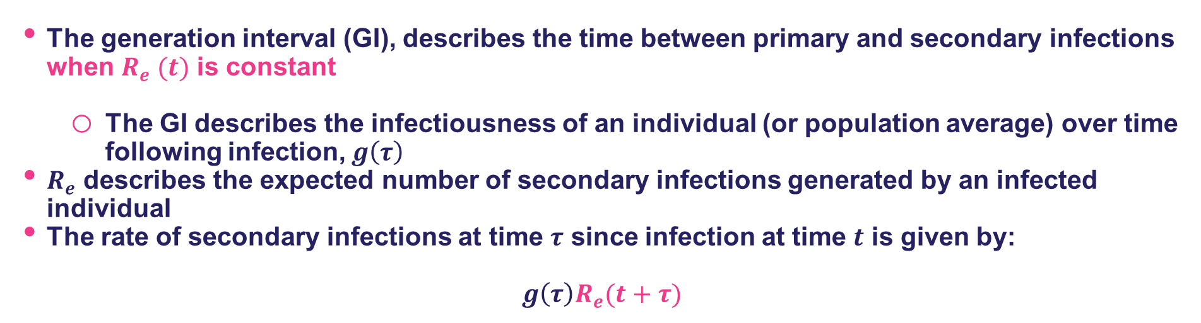

Infection incidence, the generation interval and $R_{e}$
The generation interval (GI), describes the time between primary and secondary infections when $R_{e} (t)$ is constant
The GI describes the infectiousness of an individual (or population average) over time following infection, $g\left(τ\right)$
$R_{e}$ describes the expected number of secondary infections generated by an infected individual
The rate of secondary infections at time $τ$ since infection at time $t$ is given by:
$$g\left(τ\right)R_{e}(t+τ)$$

Slide 11
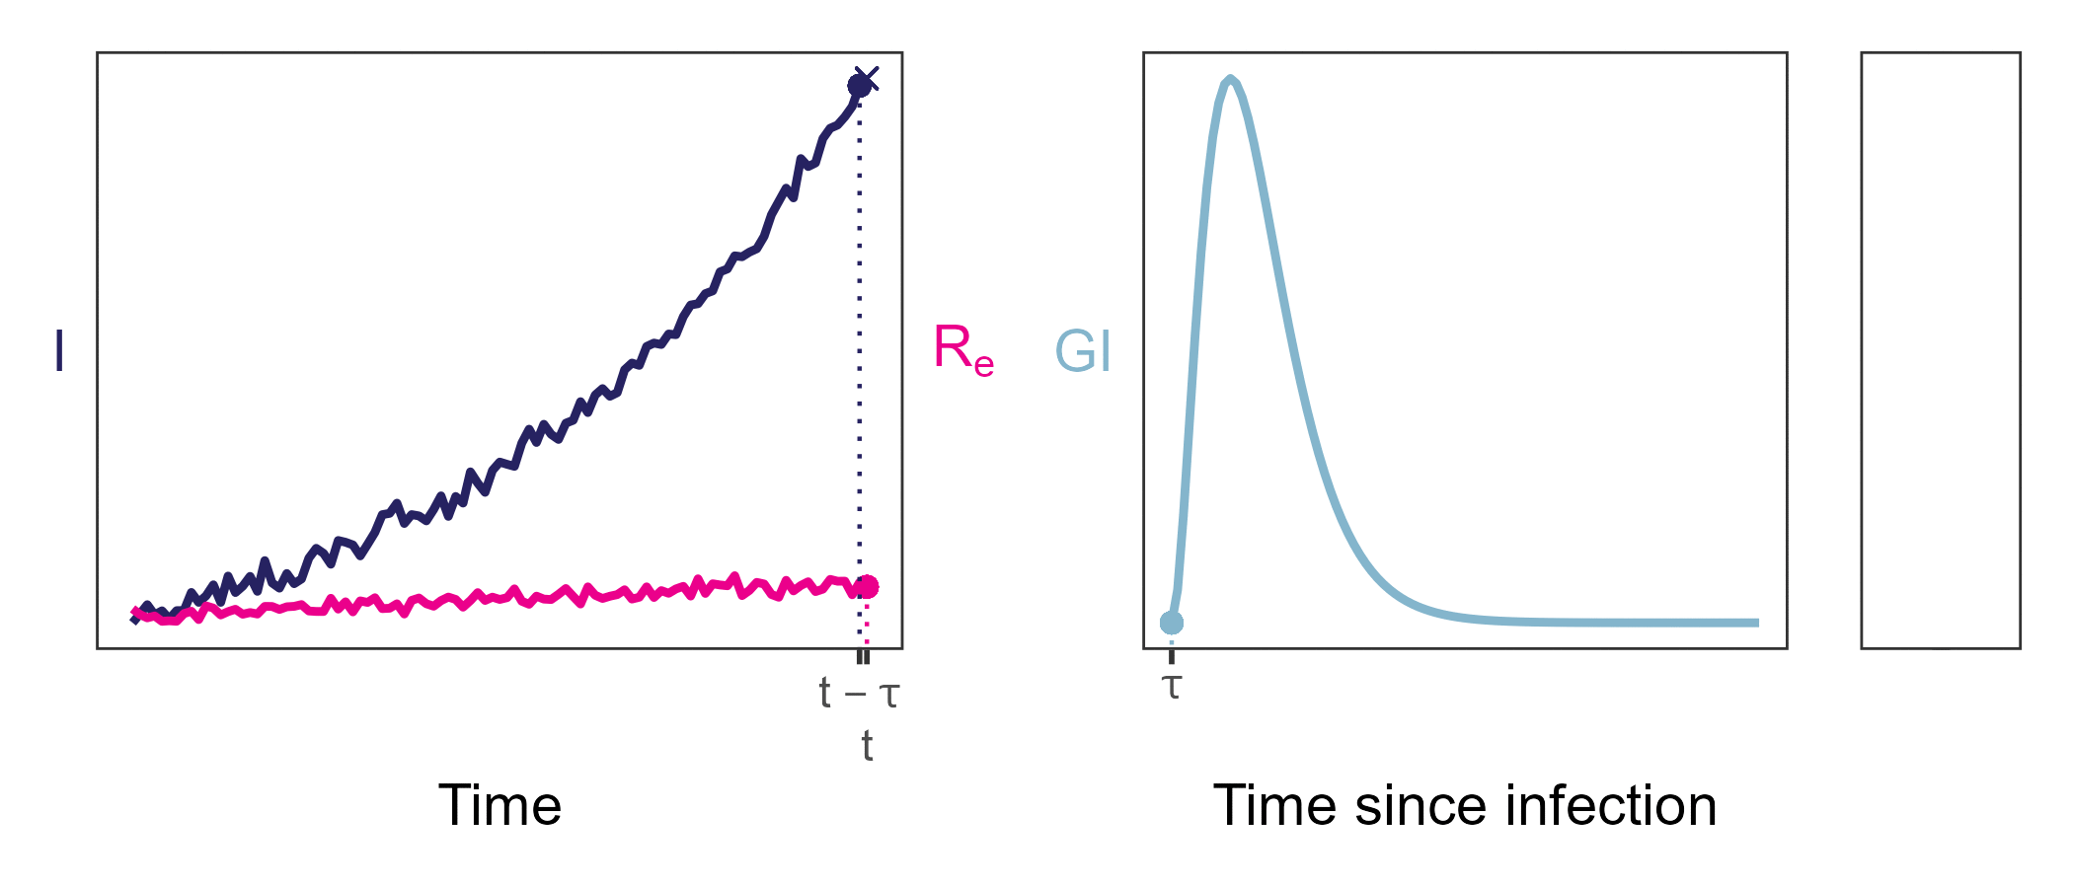
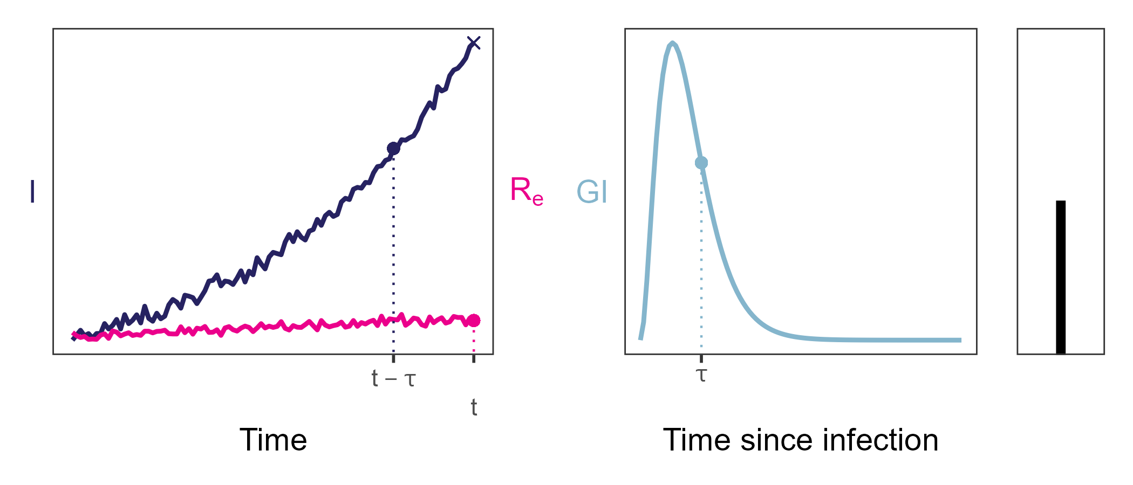
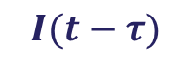

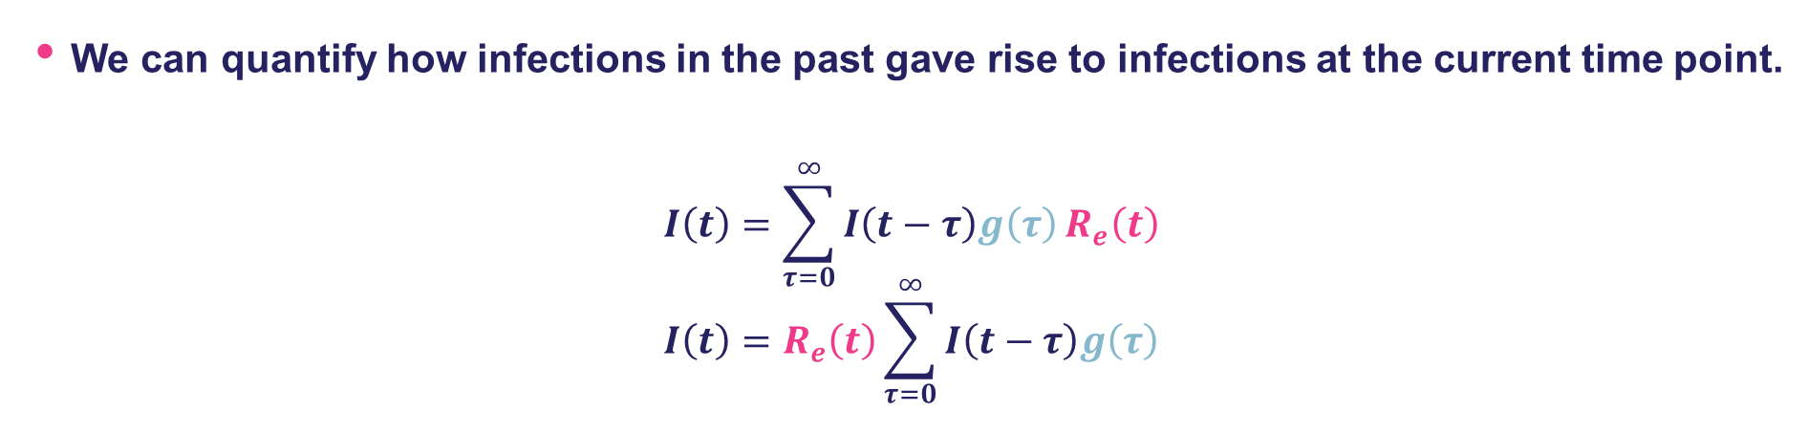
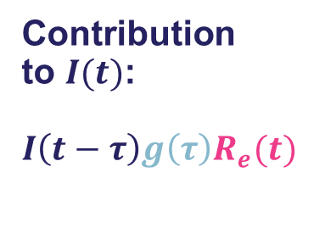
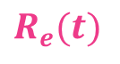
Infection incidence, the generation interval and $R_{e}$
We can quantify how infections in the past gave rise to infections at the current time point.
$$I\left(t\right)=\sum_{τ=0}^{∞}{I\left(t−τ\right)g\left(τ\right)}R_{e}\left(t\right)$$
$$I\left(t\right)=R_{e}\left(t\right)\sum_{τ=0}^{∞}{I\left(t−τ\right)g\left(τ\right)}$$
Infection incidence on current day
GI distribution
Effective reproduction number
Infections incidence on previous days
$$I(t−τ)$$
$$g\left(τ\right)$$
Contribution
to $I(t)$:
$$I\left(t−τ\right)g\left(τ\right)R_{e}(t)$$
$$R_{e}(t)$$

Slide 12
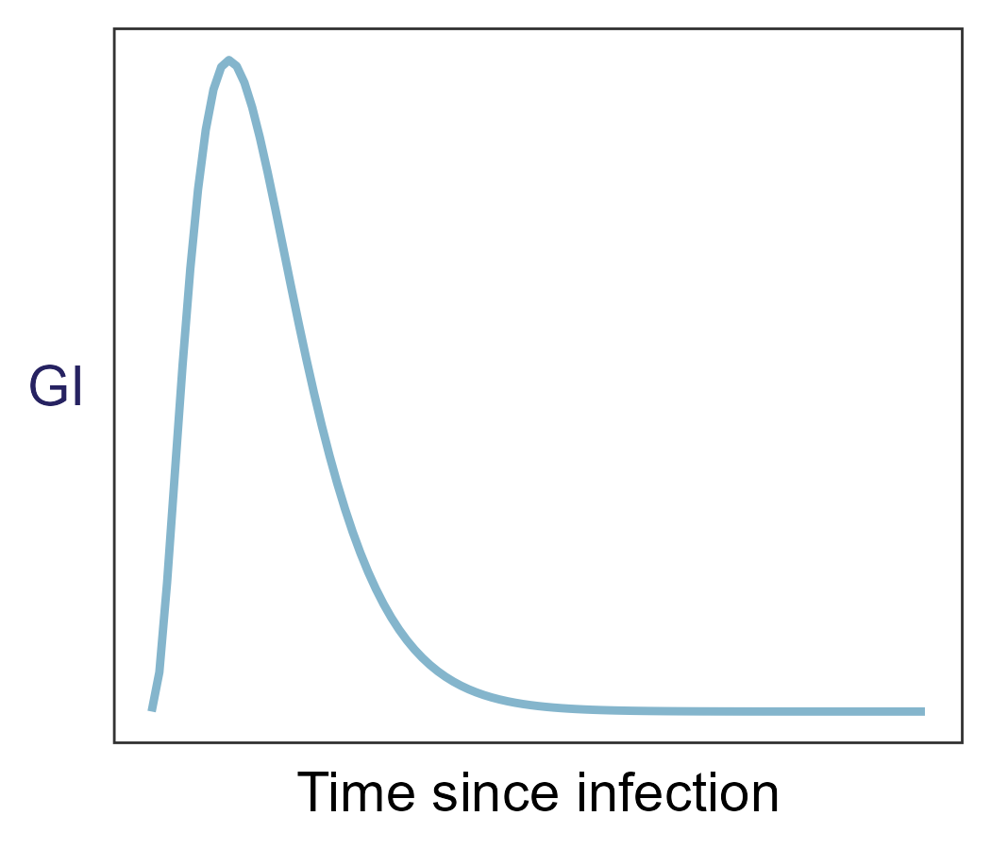

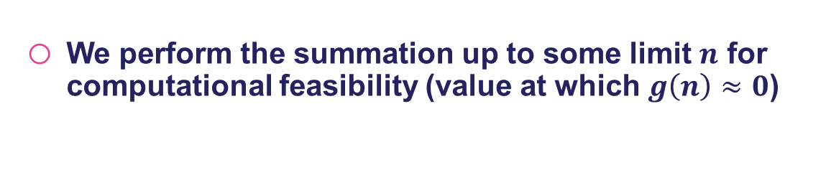
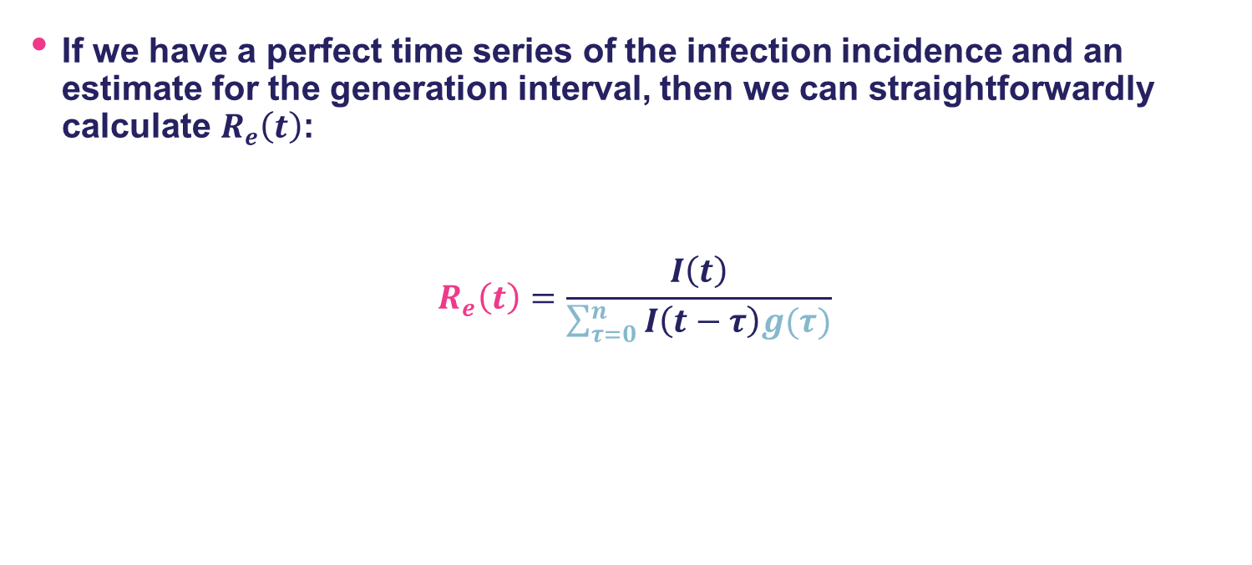
How do we estimate $R_{e}\left(t\right)$?
If we have a perfect time series of the infection incidence and an estimate for the generation interval, then we can straightforwardly calculate $R_{e}\left(t\right)$:
$$R_{e}\left(t\right)=\frac{I\left(t\right)}{\sum_{τ=0}^{n}{I\left(t−τ\right)g(τ)}}$$
Infection incidence on current day
Effective reproduction number
GI distribution
Infection incidence on previous days
We perform the summation up to some limit $n$ for computational feasibility (value at which $g\left(n\right)≈0$)

Slide 13
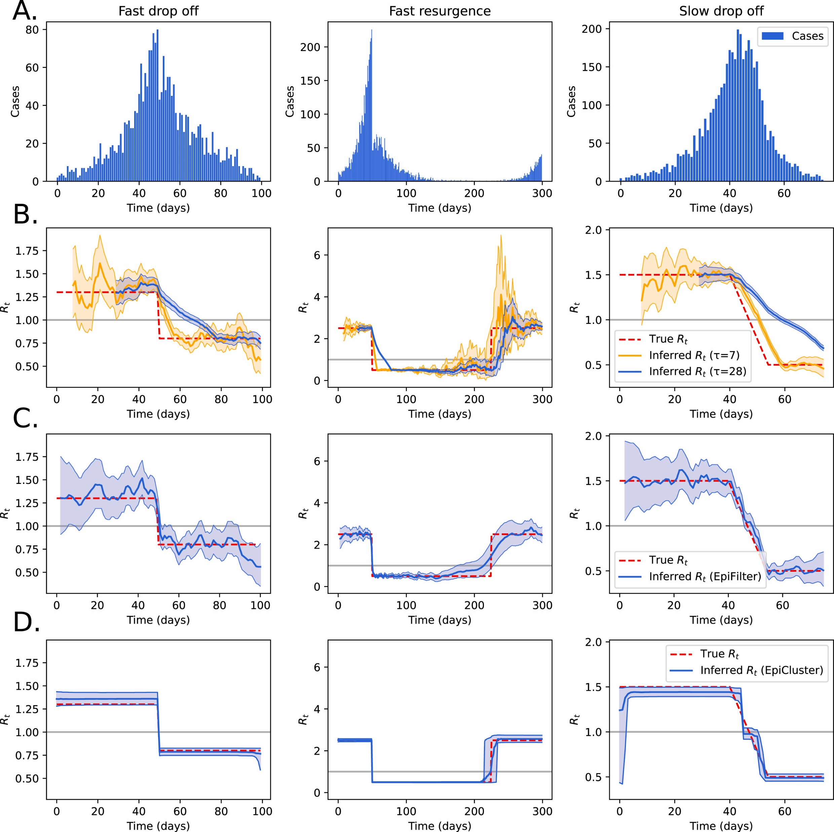
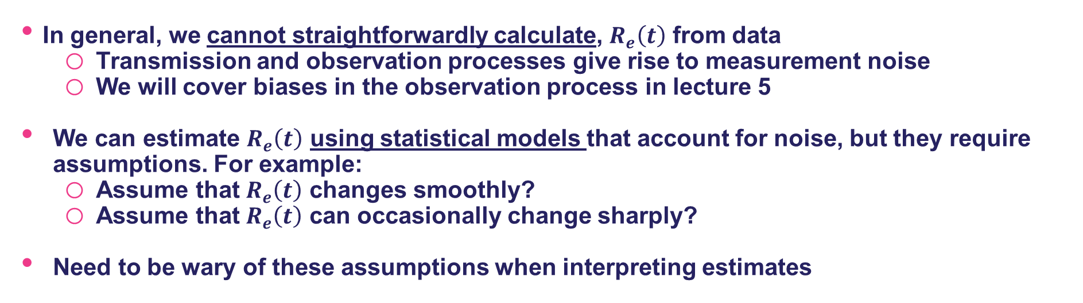
How do we estimate $R_{e}\left(t\right)$?
In general, we cannot straightforwardly calculate, $R_{e}\left(t\right)$ from data
Transmission and observation processes give rise to measurement noise
We will cover biases in the observation process in lecture 5
We can estimate $R_{e}\left(t\right)$ using statistical models that account for noise, but they require assumptions. For example:
Assume that $R_{e}\left(t\right)$ changes smoothly?
Assume that $R_{e}\left(t\right)$ can occasionally change sharply?
Need to be wary of these assumptions when interpreting estimates
Creswell et al. 2023. Journal of Theoretical Biology

Slide 14
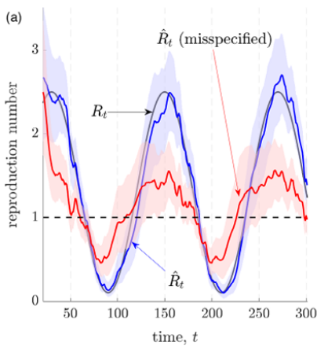
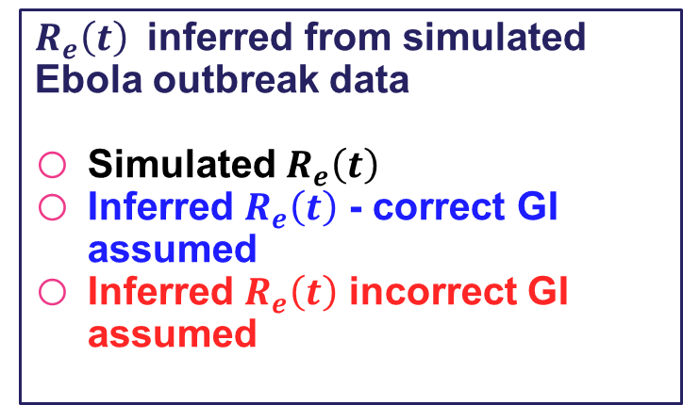
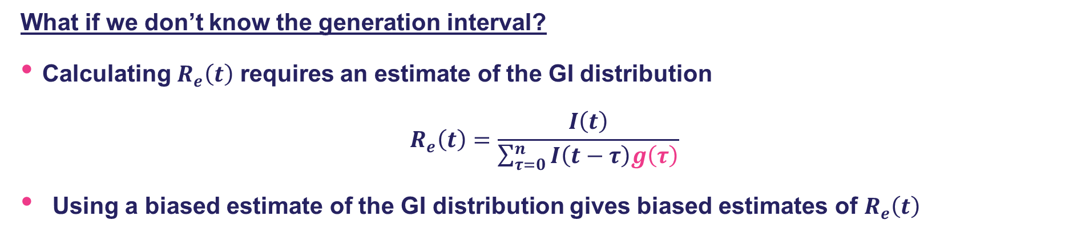
How do we estimate $R_{e}\left(t\right)$?
What if we don’t know the generation interval?
Calculating $R_{e}\left(t\right)$ requires an estimate of the GI distribution
$$R_{e}\left(t\right)=\frac{I\left(t\right)}{\sum_{τ=0}^{n}{I\left(t−τ\right)g\left(τ\right)}}$$
Using a biased estimate of the GI distribution gives biased estimates of $R_{e}\left(t\right)$
$R_{e}\left(t\right)$ inferred from simulated Ebola outbreak data
Simulated $R_{e}\left(t\right)$
Inferred $R_{e}\left(t\right)$ - correct GI assumed
Inferred $R_{e}\left(t\right)$ incorrect GI assumed
Parag et al. 2022. J R Stat Soc Ser A Stat Soc

Slide 15
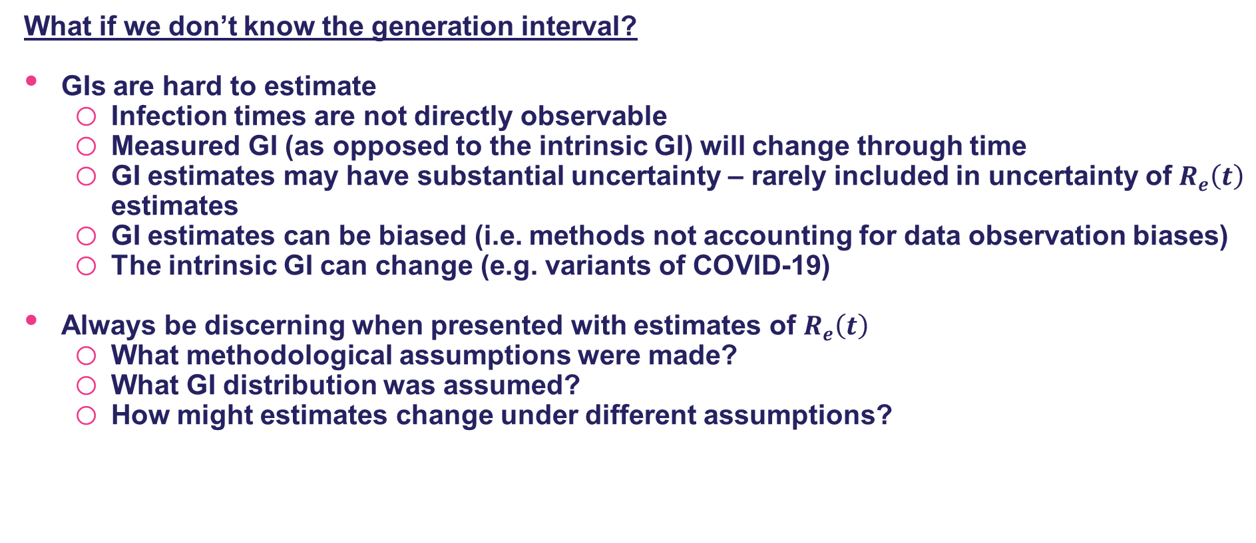
How do we estimate $R_{e}\left(t\right)$?
What if we don’t know the generation interval?
GIs are hard to estimate
Infection times are not directly observable
Measured GI (as opposed to the intrinsic GI) will change through time
GI estimates may have substantial uncertainty – rarely included in uncertainty of $R_{e}\left(t\right)$ estimates
GI estimates can be biased (i.e. methods not accounting for data observation biases)
The intrinsic GI can change (e.g. variants of COVID-19)
Always be discerning when presented with estimates of $R_{e}\left(t\right)$
What methodological assumptions were made?
What GI distribution was assumed?
How might estimates change under different assumptions?

Slide 16
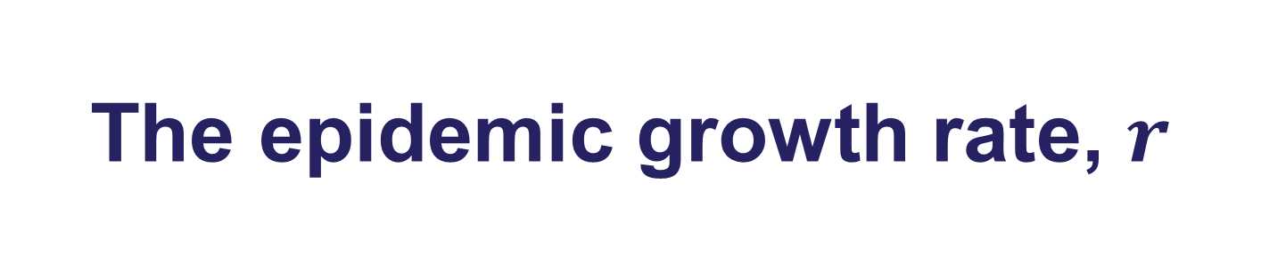
The epidemic growth rate, $r$

Slide 17
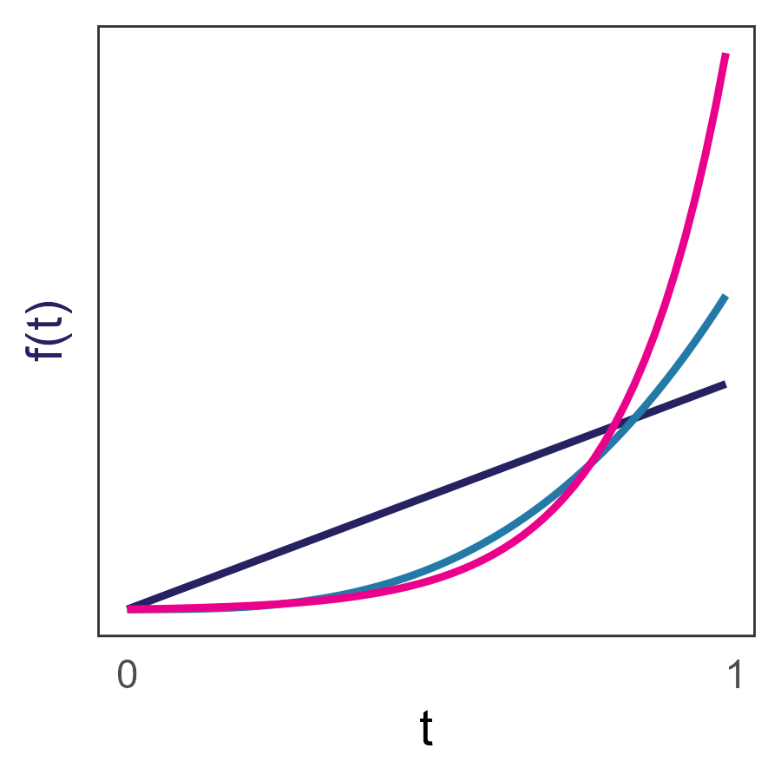
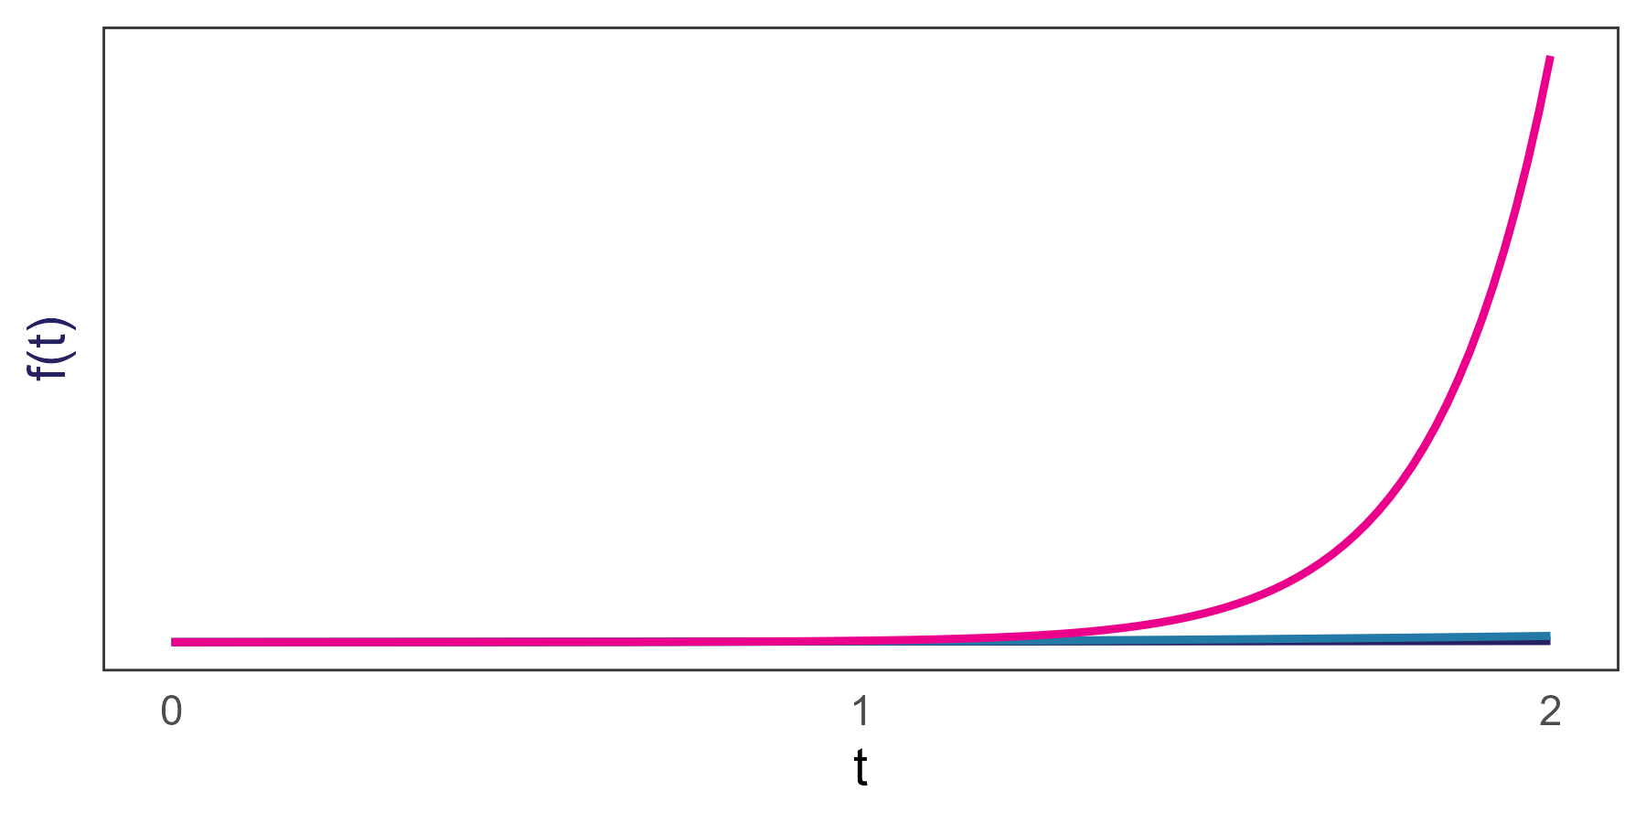
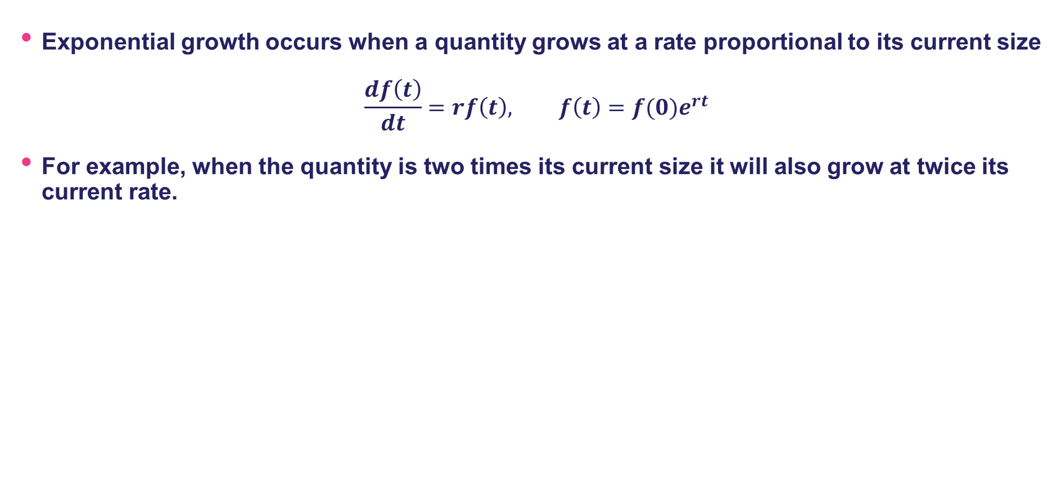
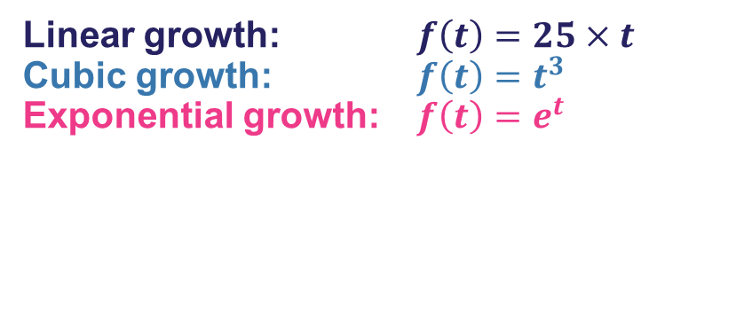
What is exponential growth?
Exponential growth occurs when a quantity grows at a rate proportional to its current size
$$\frac{df\left(t\right)}{dt}=rf\left(t\right), f\left(t\right)={f(0)e}^{rt}$$
For example, when the quantity is two times its current size it will also grow at twice its current rate.
Linear growth: $f\left(t\right)=25×t$
Cubic growth: $f\left(t\right)=t^{3}$
Exponential growth: $f\left(t\right)=e^{t}$

Slide 18
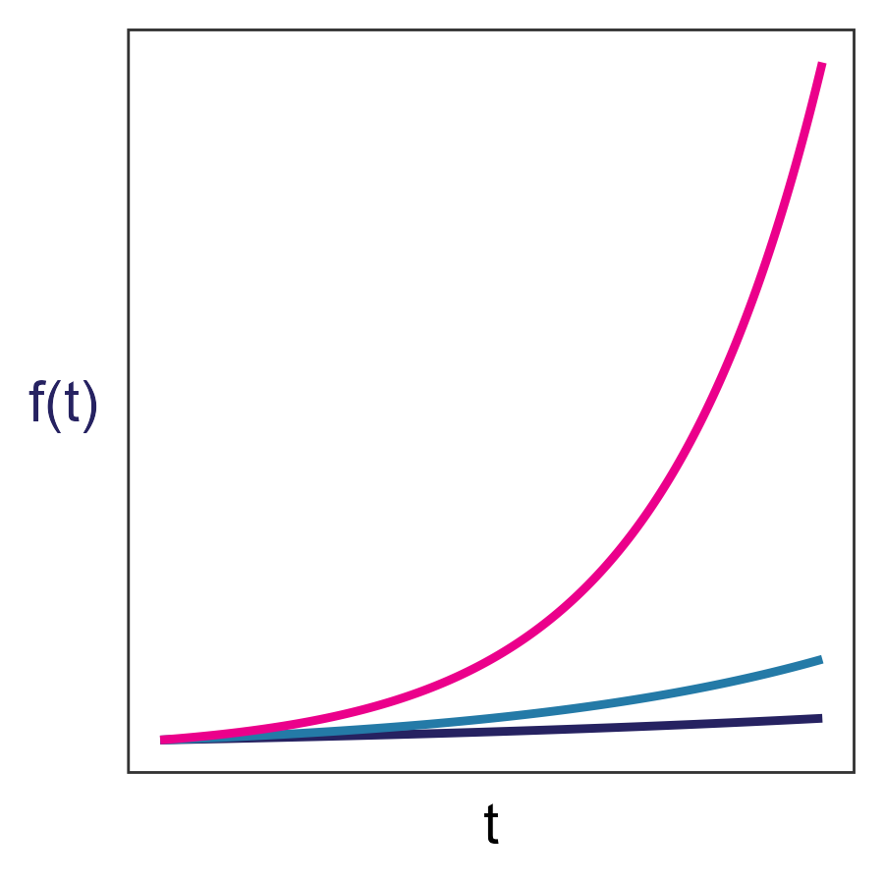
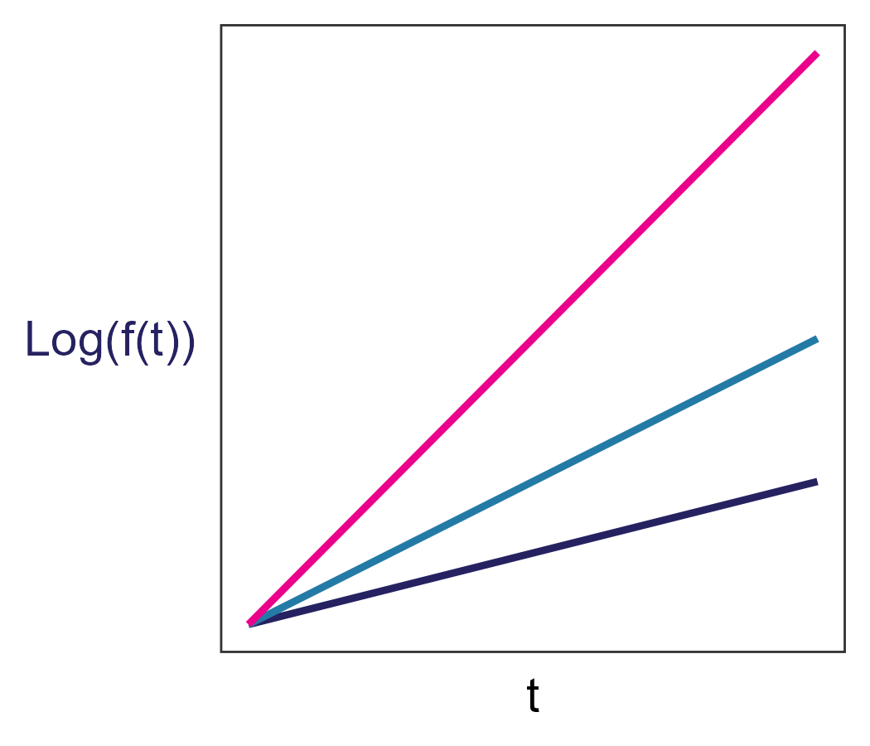
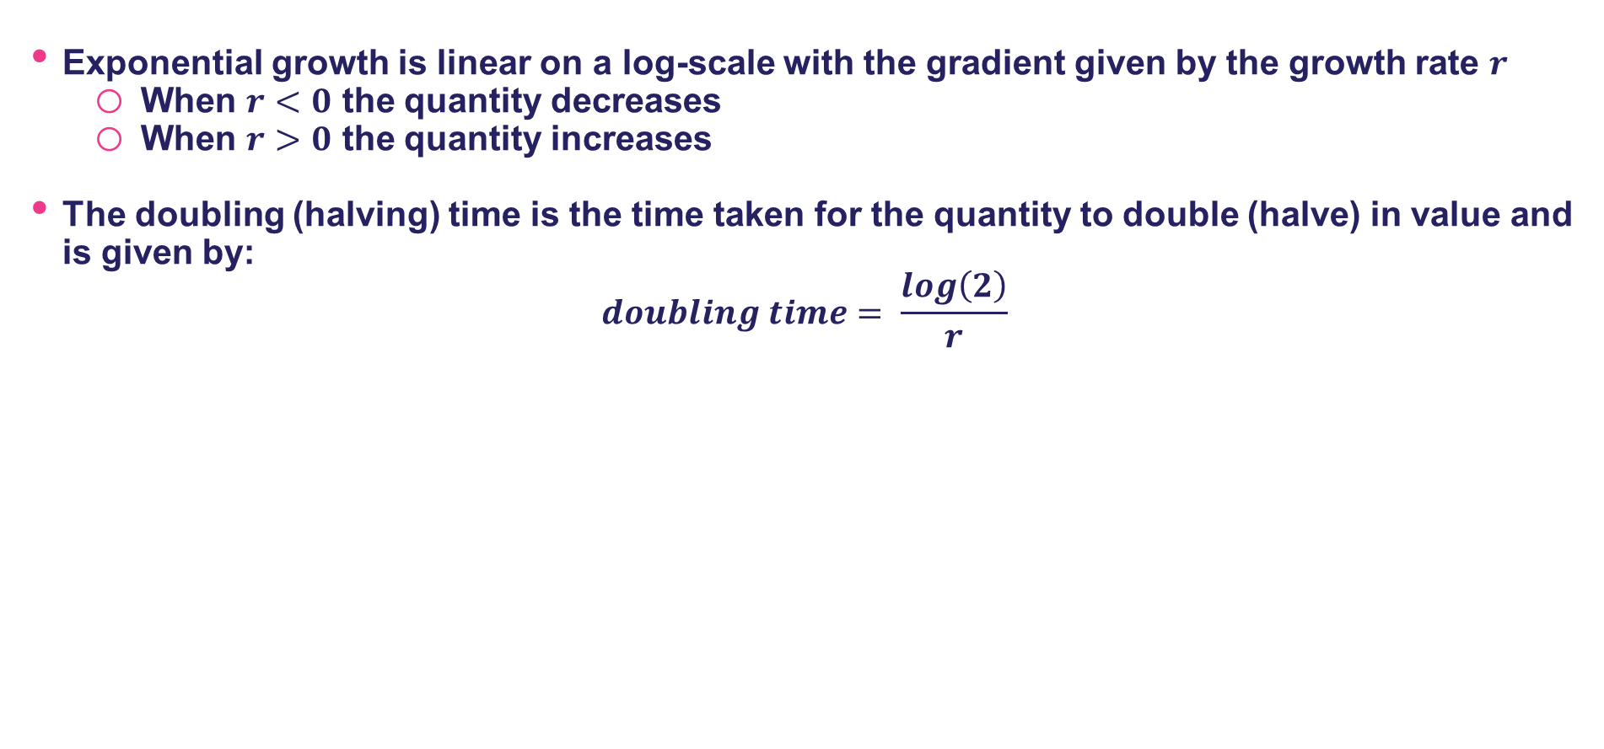
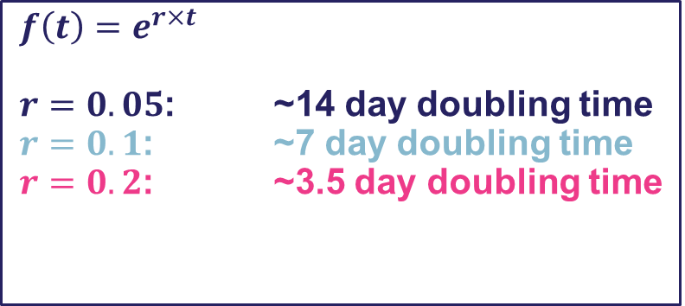
What is exponential growth?
Exponential growth is linear on a log-scale with the gradient given by the growth rate $r$
When $r<0$ the quantity decreases
When $r>0$ the quantity increases
The doubling (halving) time is the time taken for the quantity to double (halve) in value and is given by:
$$doubling time= \frac{log\left(2\right)}{r}$$
$$f\left(t\right)=e^{r×t}$$
$r=0.05$: ~14 day doubling time
$r=0.1$: ~7 day doubling time
$r=0.2$: ~3.5 day doubling time

Slide 19
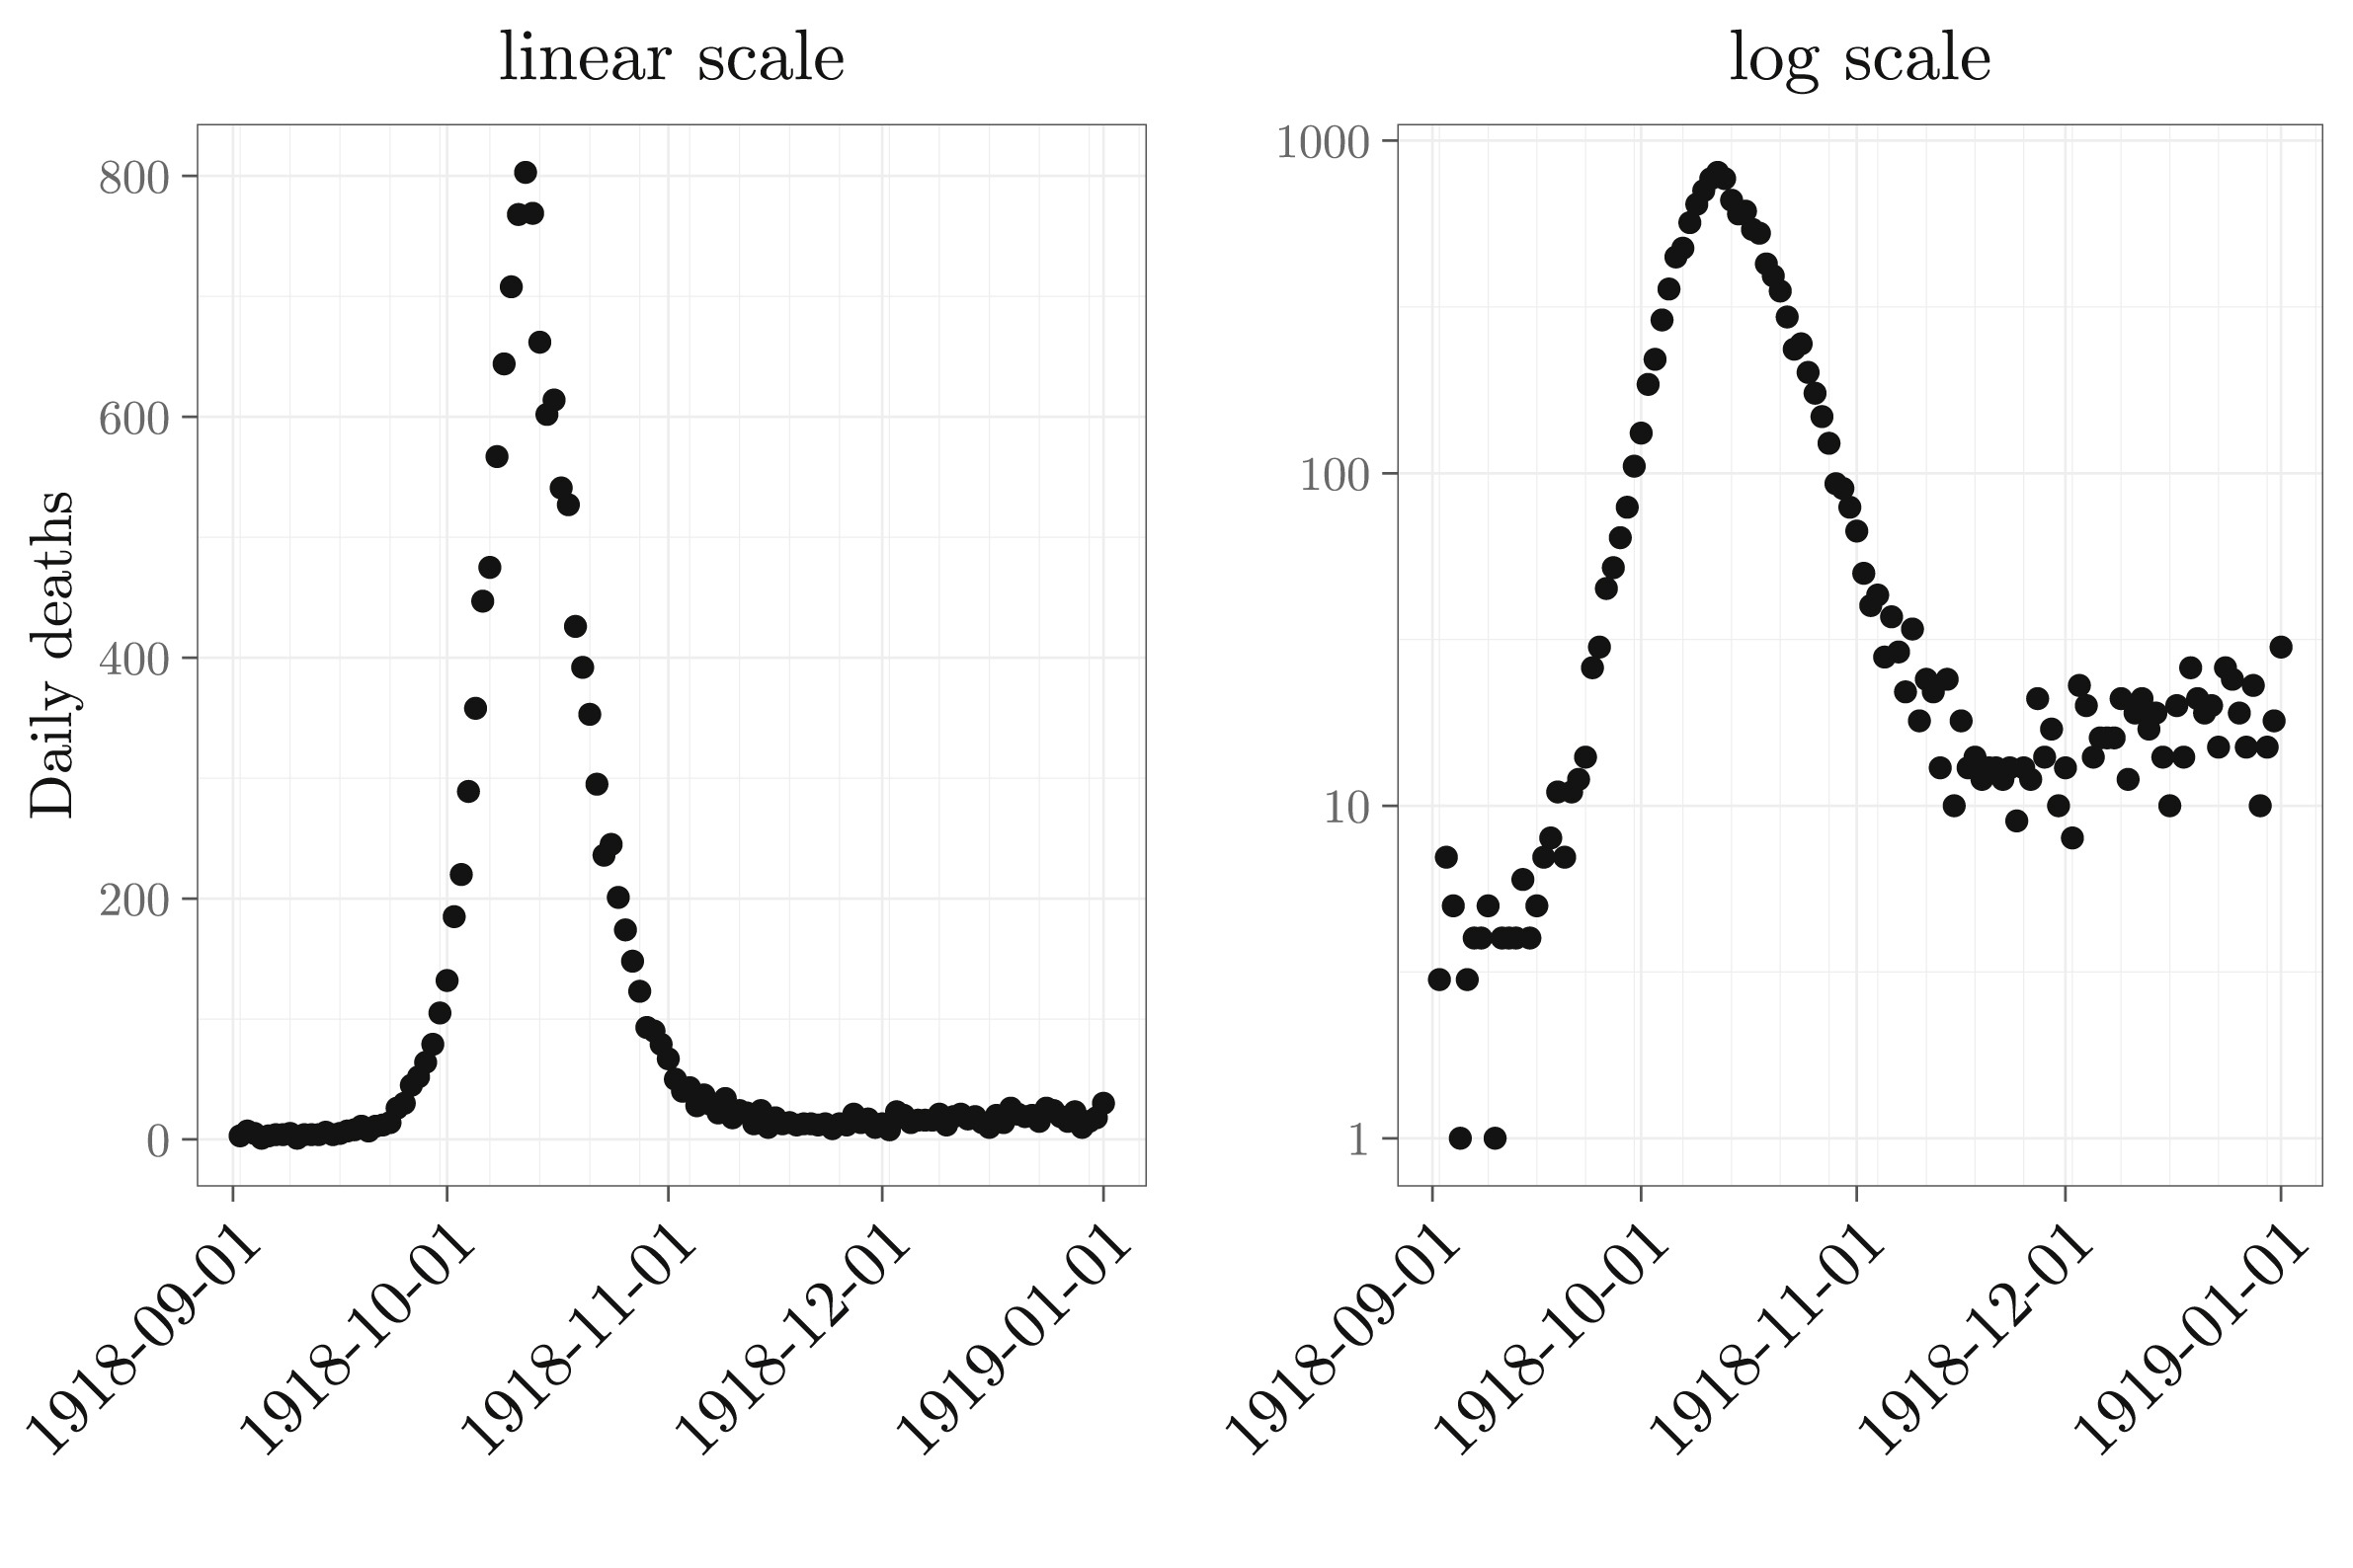
Why is exponential growth relevant to epidemics?
Epidemics often exhibit sustained periods of constant exponential growth/decline:
Influenza Deaths in Philadelphia during the 1918 pandemic
Ma 2020. Infectious Disease Modelling

Slide 20
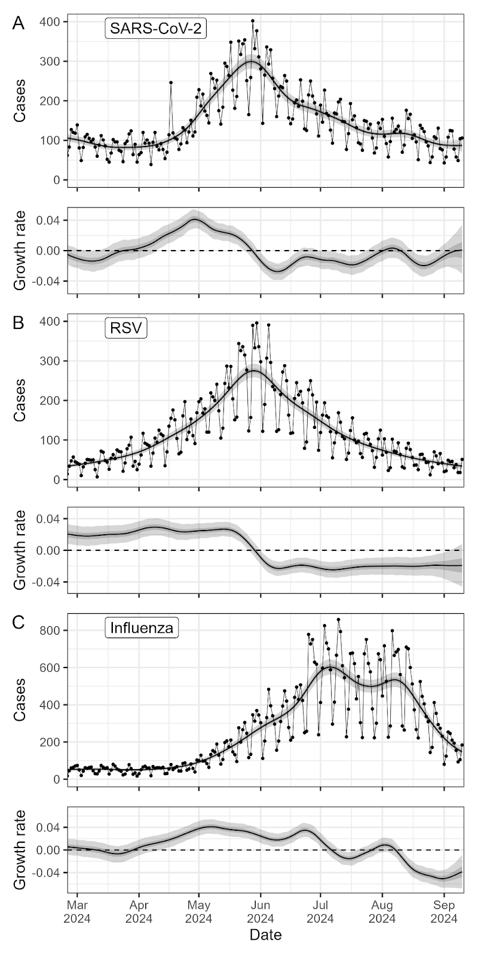
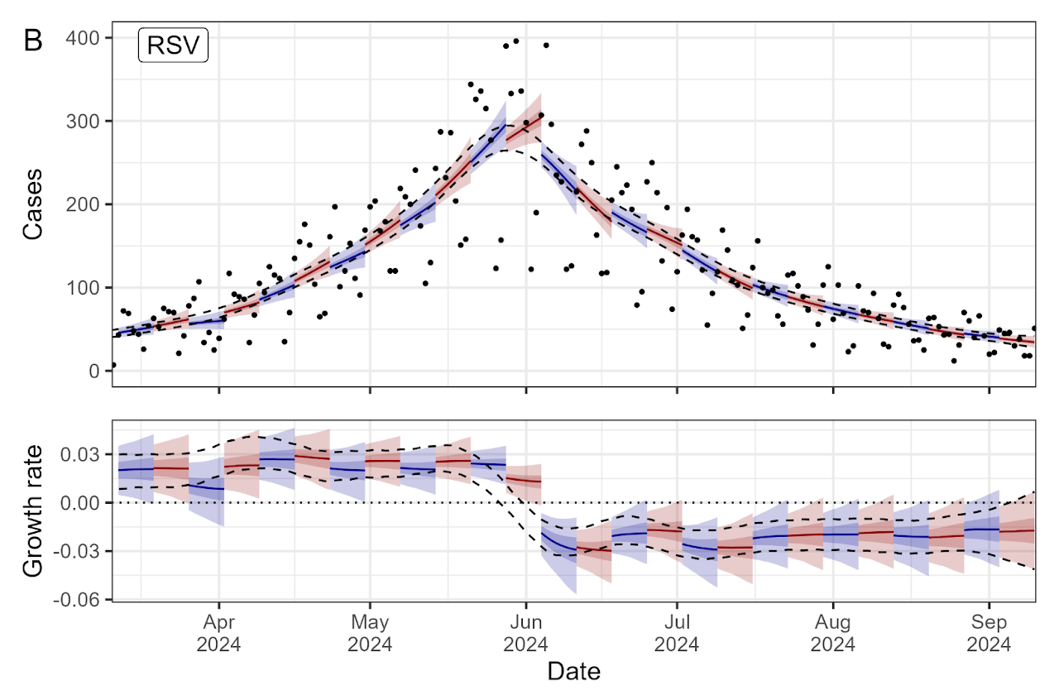
Infection incidence and the epidemic growth rate
The growth rate will change over time
The growth rate will change fastest at the epidemic peak from above to below 0
This can lead to overestimates of future infection levels when forecasts are made immediately prior to epidemic peaks
Eales 2025. Communicable Diseases Intelligence

Slide 21
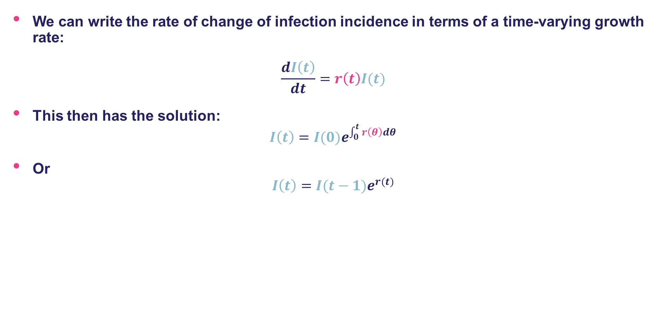
Infection incidence and the epidemic growth rate
We can write the rate of change of infection incidence in terms of a time-varying growth rate:
$$\frac{dI\left(t\right)}{dt}=r\left(t\right)I(t)$$
This then has the solution:
$$I\left(t\right)={I(0)e}^{\int_{0}^{t}{r\left(θ\right)dθ}}$$
Or
$$I\left(t\right)={I(t−1)e}^{r(t)}$$
Infection incidence at current time
Growth rate from previous time to current time
Infections incidence at previous time

Slide 22
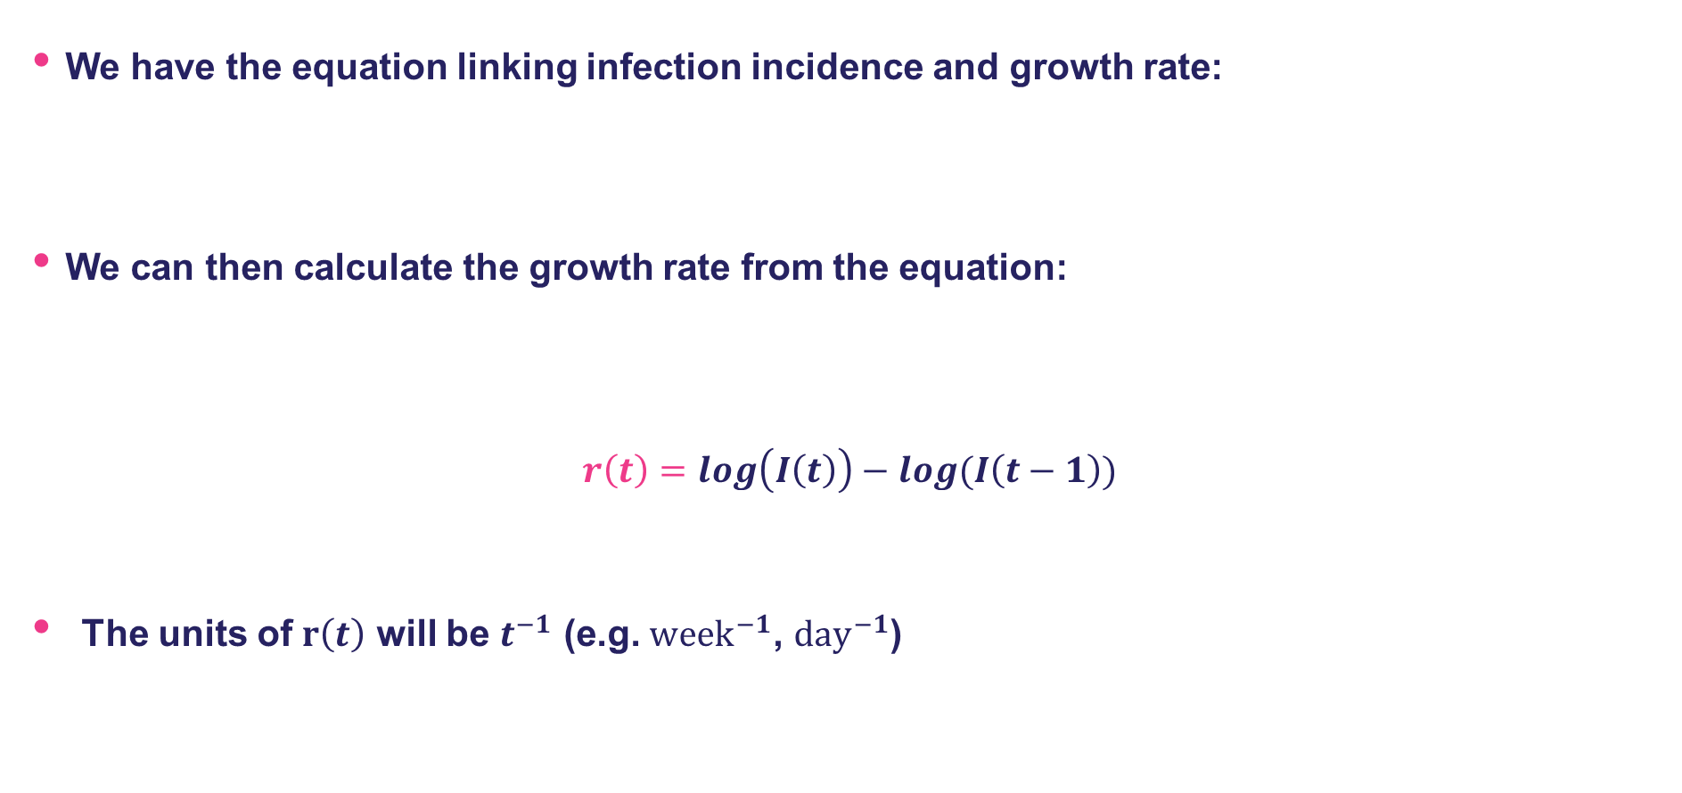

How do we estimate the epidemic growth rate?
We have the equation linking infection incidence and growth rate:
We can then calculate the growth rate from the equation:
$$r\left(t\right)=log\left(I\left(t\right)\right)−log(I\left(t−1\right))$$
The units of $r\left(t\right)$ will be $t^{−1}$ (e.g. ${week}^{−1}$, ${day}^{−1}$)
$$I\left(t\right)={I(t−1)e}^{r(t)}$$
Epidemic growth rate
Difference between log of infection incidence at current time and previous time step

Slide 23
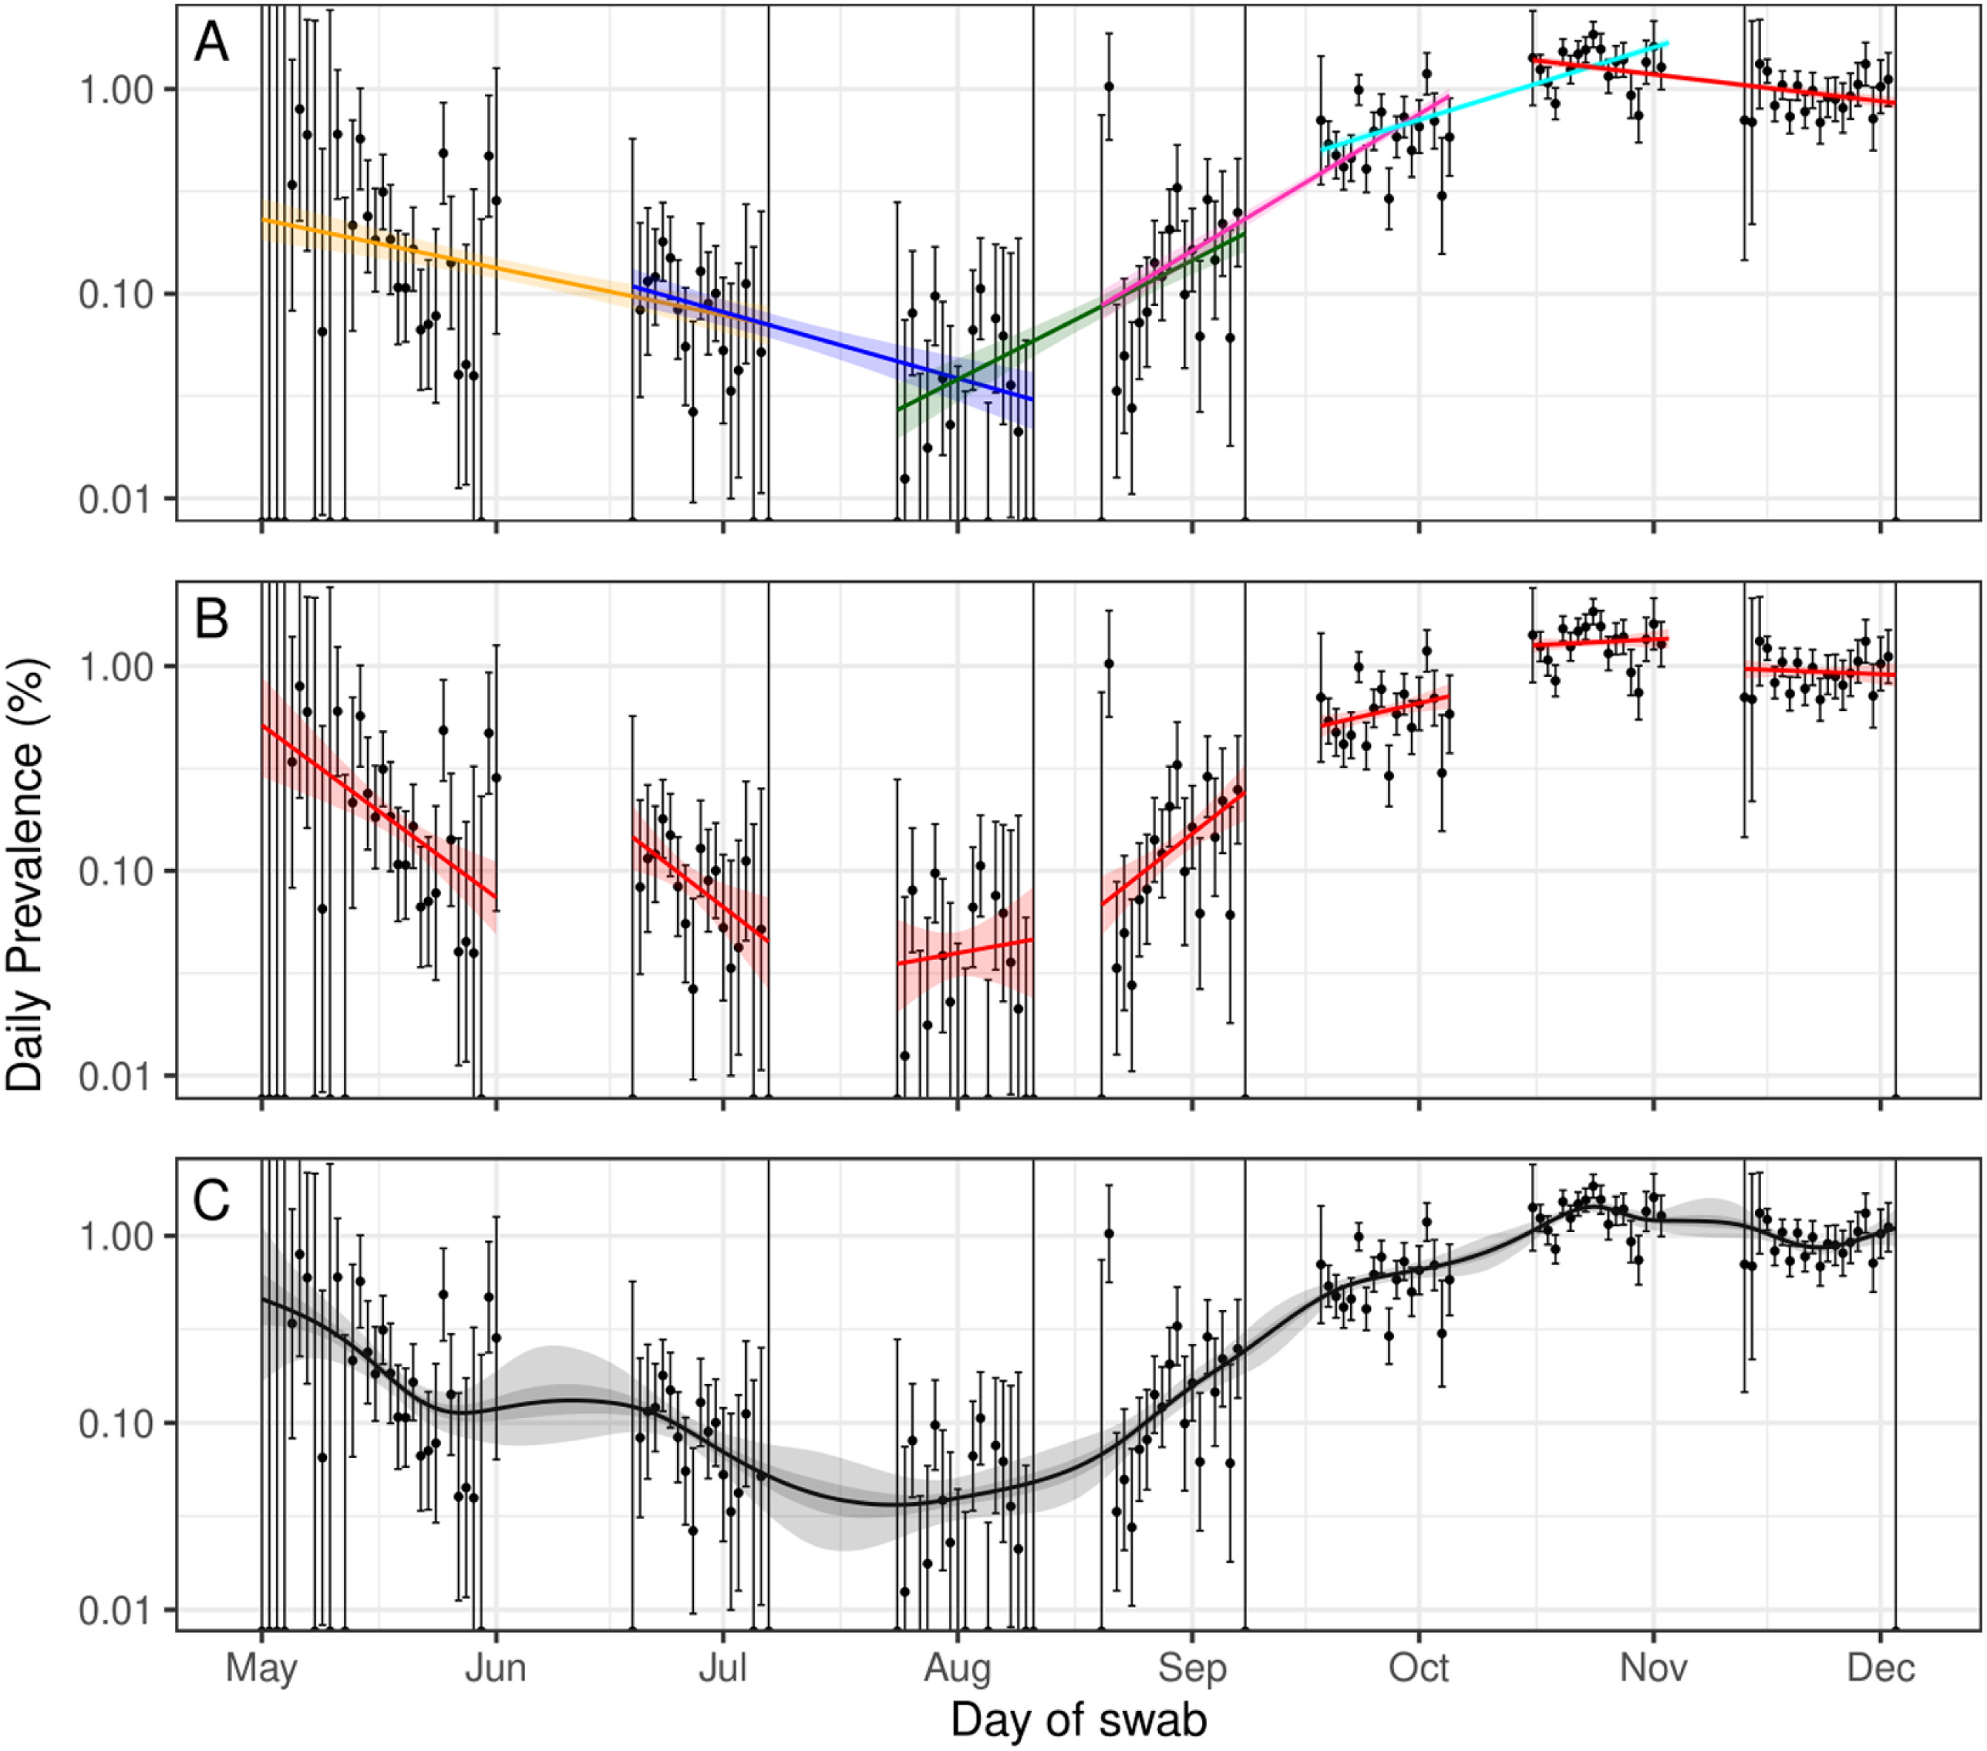
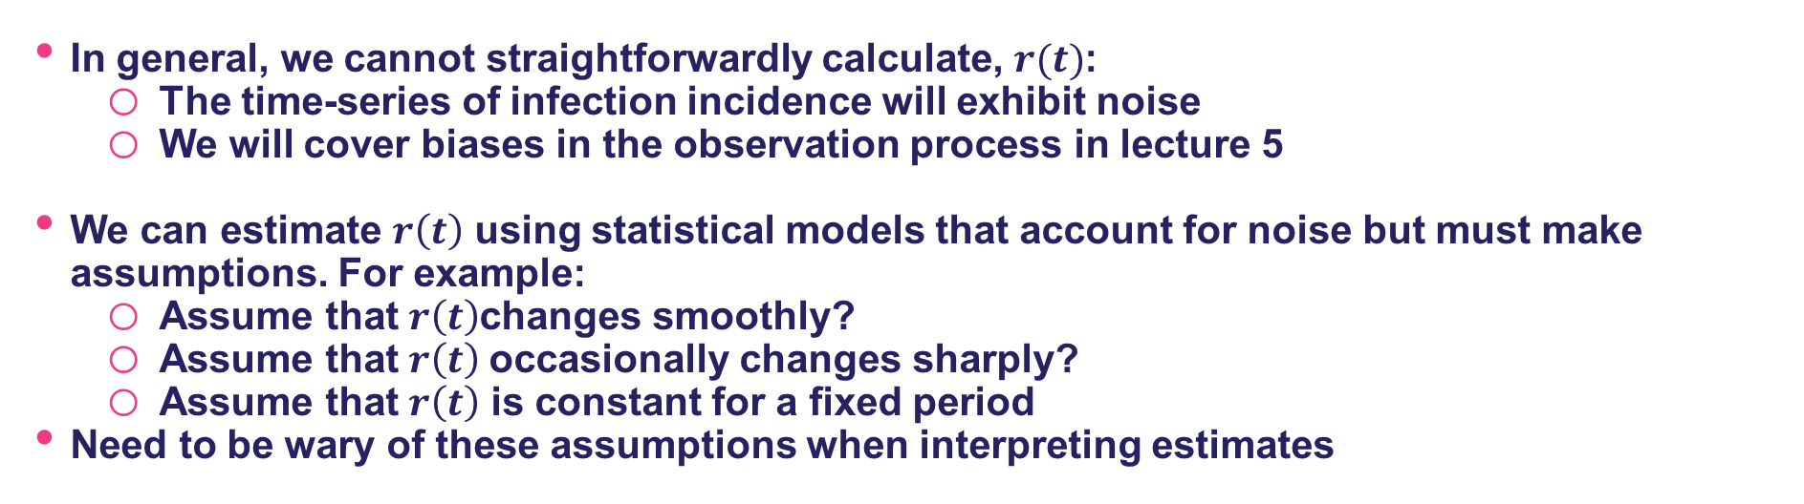
How do we estimate the epidemic growth rate?
In general, we cannot straightforwardly calculate, $r(t)$:
The time-series of infection incidence will exhibit noise
We will cover biases in the observation process in lecture 5
We can estimate $r\left(t\right)$ using statistical models that account for noise but must make assumptions. For example:
Assume that $r\left(t\right)$changes smoothly?
Assume that $r\left(t\right)$occasionally changes sharply?
Assume that $r\left(t\right)$ is constant for a fixed period
Need to be wary of these assumptions when interpreting estimates
Eales et al. 2022. Epidemics

Slide 24
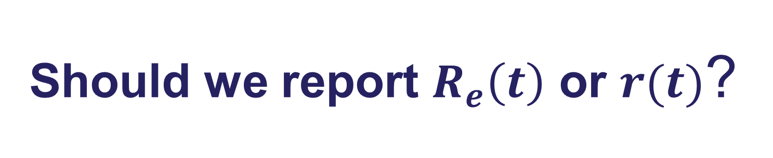
Should we report $R_{e}\left(t\right)$ or $r(t)$?

Slide 25

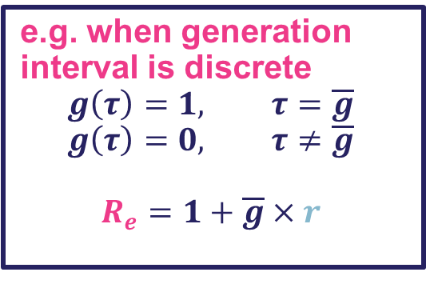
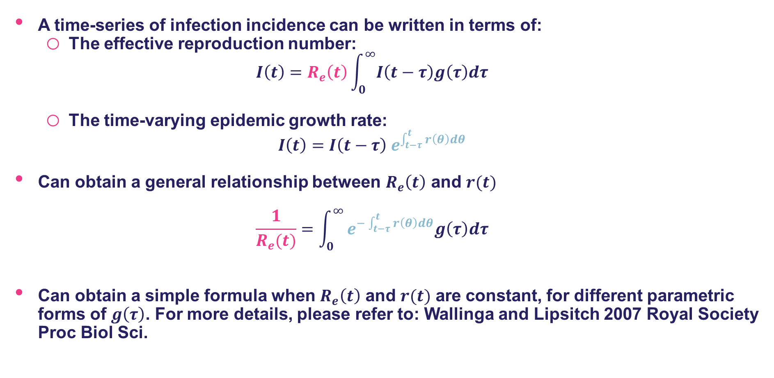
The relationship between $R_{e}\left(t\right)$ and $r(t)$
A time-series of infection incidence can be written in terms of:
The effective reproduction number:
$$I\left(t\right)=R_{e}\left(t\right)\int_{0}^{∞}{I\left(t−τ\right)g\left(τ\right)dτ}$$
The time-varying epidemic growth rate:
$$I\left(t\right)={I\left(t−τ\right) e}^{\int_{t−τ}^{t}{r\left(θ\right)dθ}}$$
Can obtain a general relationship between $R_{e}\left(t\right)$ and $r(t)$
$$\frac{1}{R_{e}(t)}=\int_{0}^{∞}{e^{−\int_{t−τ}^{t}{r\left(θ\right)dθ}}g\left(τ\right)dτ}$$
Can obtain a simple formula when $R_{e}\left(t\right)$ and $r(t)$ are constant, for different parametric forms of $g\left(τ\right)$. For more details, please refer to: Wallinga and Lipsitch 2007 Royal Society Proc Biol Sci.
e.g. when generation interval is discrete
$$g\left(τ\right)=1, τ=\overline{g}$$
$$g\left(τ\right)=0, τ≠\overline{g}$$
$$R_{e}=1+\overline{g}×r$$

Slide 26
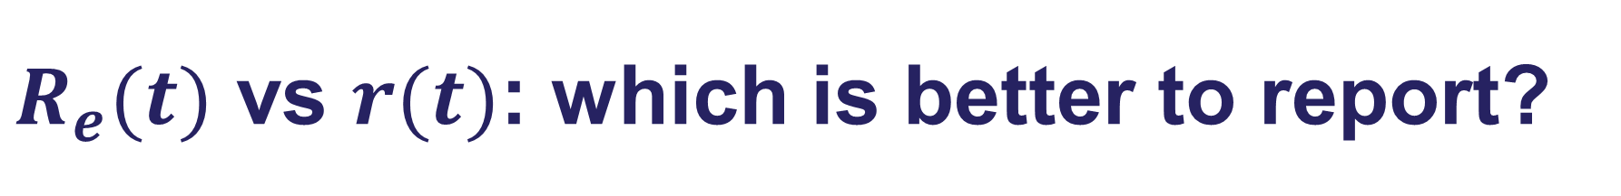
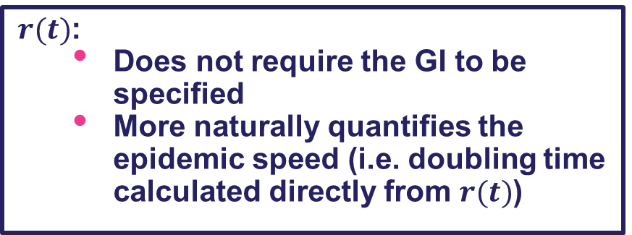
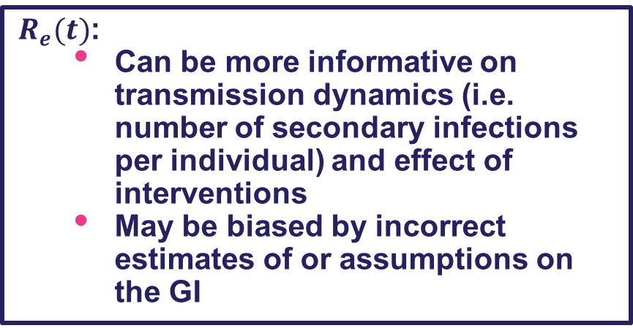
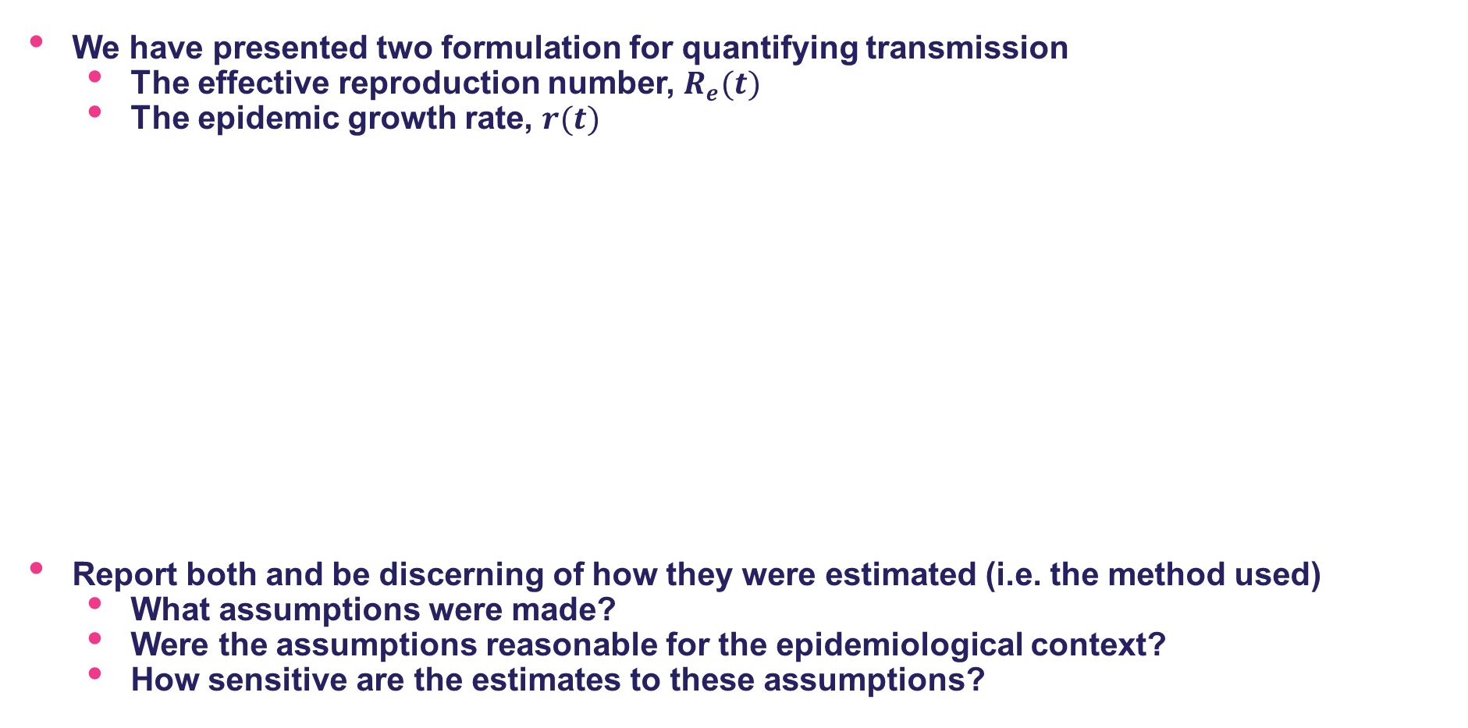
$R_{e}(t)$ vs $r(t)$: which is better to report?
We have presented two formulation for quantifying transmission
The effective reproduction number, $R_{e}(t)$
The epidemic growth rate, $r(t)$
Report both and be discerning of how they were estimated (i.e. the method used)
What assumptions were made?
Were the assumptions reasonable for the epidemiological context?
How sensitive are the estimates to these assumptions?
$R_{e}(t)$:
Can be more informative on transmission dynamics (i.e. number of secondary infections per individual) and effect of interventions
May be biased by incorrect estimates of or assumptions on the GI
$r(t)$:
Does not require the GI to be specified
More naturally quantifies the epidemic speed (i.e. doubling time calculated directly from $r(t)$)

Slide 27
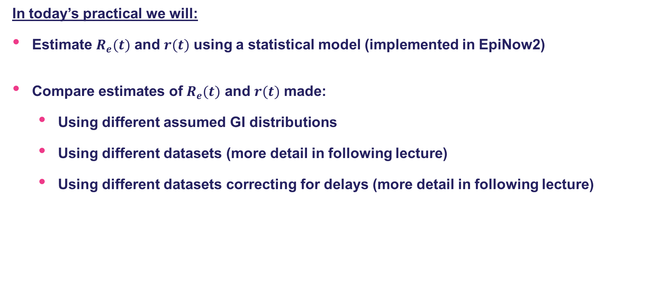
Practical
In today’s practical we will:
Estimate $R_{e}(t)$ and $r(t)$ using a statistical model (implemented in EpiNow2)
Compare estimates of $R_{e}(t)$ and $r(t)$ made:
Using different assumed GI distributions
Using different datasets (more detail in following lecture)
Using different datasets correcting for delays (more detail in following lecture)

Slide 28
References
Parag KV, Thompson RN, Donnelly CA. Are epidemic growth rates more informative than reproduction numbers? J R Stat Soc Ser A Stat Soc. 2022. doi:10.1111/rssa.12867
Creswell R, Robinson M, Gavaghan D, Parag KV, Lei CL, Lambert B. A Bayesian nonparametric method for detecting rapid changes in disease transmission. J Theor Biol. 2023;558: 111351.
Chowell G, Viboud C, Simonsen L, Moghadas SM. Characterizing the reproduction number of epidemics with early subexponential growth dynamics. J R Soc Interface. 2016;13. doi:10.1098/rsif.2016.0659
Eales O, Ainslie KEC, Walters CE, Wang H, Atchison C, Ashby D, et al. Appropriately smoothing prevalence data to inform estimates of growth rate and reproduction number. Epidemics. 2022;40: 100604.
Wallinga J, Lipsitch M. How generation intervals shape the relationship between growth rates and reproductive numbers. Proc Biol Sci. 2007;274: 599–604.

